Slide 1
Rapid Re-Housing in Pierce County
Anne Marie Edmunds | Program Specialist
Mar 22, 2019 | Annemarie.edmunds@piercecountywa.gov

Slide 2
Overview of Rapid Rehousing
Rapid Re-Housing
Graduated, short-term financial assistance and service supports in market-rate, permanent housing

Slide 3
Overview of Transitional Housing
Transitional Housing
Temporary, site-based,
non-permanent housing with mandatory, required services

Slide 4
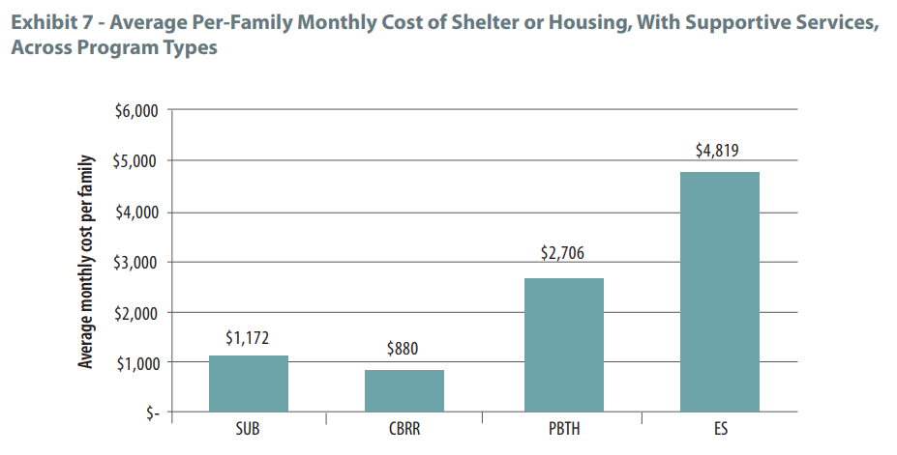
Why Rapid Rehousing?
The most comprehensive federal study of homeless housing interventions suggested rapid rehousing (RRH) was more cost-effective than transitional housing (TH).

Slide 5
How does the cost compare?
Families obtained housing at relatively low cost

Slide 6
How many served in RRH?
Since 2013, more than 6,000 people (in about 2,600 households) have been housed through rapid rehousing programs in Pierce County.

Slide 7
How long does it take?
Of those who find housing, about half of households move in within 40 days.

Slide 8
How long do they receive help?
On average, households spend about seven months in a rapid rehousing program—though many households successfully exit the program much sooner.

Slide 9
Are they successful in RRH?
■ Successful Exit
■ Unsuccessful Exit
Almost 90% of households who move in to a unit ultimately retain their leases or exit to other permanent housing.

Slide 10
How much do they receive?
Households receive an average of about $6,000* of financial assistance over the course of a program.

Slide 11
Do they stay housed?
Upon leaving a rapid rehousing program, about 90% of households retain their housing for at least one year.

Slide 12
Homeless Crisis Response System
which in some cases leads to…
Coordinated Entry
Creative Conversation
Priority Pool
End Homeless Crisis
Referral
This could be RRH or PSH
Households may or may not be in shelter when they contact CE
Or rarely, TH

