Slide 1


Student loan repayment basics
© 2018 Wells Fargo Bank, N.A. All rights reserved. Public use. Materials expire 10/1/2019.

Slide 2
Today’s agenda
When does repayment begin?
Borrower responsibilities
What is a loan servicer?
Common financial aid terms
Reminders and resources

Slide 3
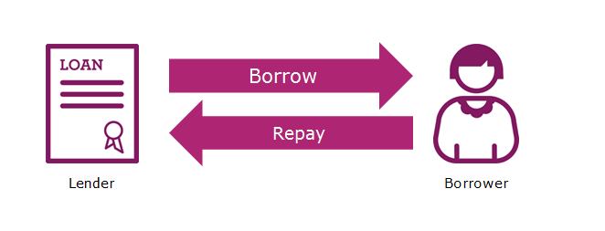
When does repayment begin?
Repayment begins when you:
Graduate
Leave school
Drop below the half-time attendance mark

Slide 4
Borrower responsibilities
Repaying your student loan(s) as agreed
  Repaying your loan even if a bill is not sent
  Opening and reading mail and email related to your student loan(s)
  Keeping your lender or servicer informed

Slide 5
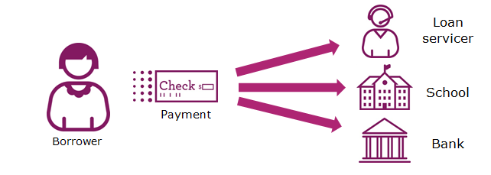
What is a loan servicer?
A company that collects payments, responds to customer service inquiries, and performs other administrative tasks associated with maintaining a federal or private student loan on behalf of a lender.

Slide 6
Finding your federal loan servicer
National Student Loan Data System
NSLDS.ed.gov
What information is available?
Loan servicer name and contact information
Your federal loans and grants
Loan details
Common financial aid questions and answers
Glossary of terms

Slide 7
Common financial aid terms
  Grace period: set period of time after you graduate, leave school, or drop below half-time enrollment before you must begin repaying your loan balance.
  Deferment: period in which a repayment of the principal and interest of your loan is temporarily postponed.
  Forbearance: period of time where you may be able to stop making payments or reduce your monthly payment for a limited time. Interest will continue to accrue on your loan.
  In-school repayment: some lenders have the option to make payments on your loan while attending school. Speak to your student loan provider.
Note: Some loans require immediate repayment once the loan is taken out. Check with your lender or servicer to find out the repayment terms for your particular loan.

Slide 8
Reminders and resources
  Find the loan servicer for federal loans using the National Student Loan Data System at NSLDS.ed.gov.
  Stay in touch with your lender or servicer.
  For more information about federal loan repayment options, visit studentaid.ed.gov.

Slide 9
Wells Fargo is here to help
Still have questions? Wells Fargo can help.
More than 45 years of helping students achieve their dream of a higher education
Learn more about private student loan refinance and consolidation options at: wellsfargo.com/consolidation
Our dedicated Student Loan Consultants will work with you to help you understand your options every step of the way. Call 1-800-456-1551 Monday to Friday 7:00 am to 8:00 pm Central Time
Learn more about money management by visiting handsonbanking.org and wellsfargo.com/pathtocredit

Slide 10
Thank you!

