Slide 1
Protecting yourself from identity theft and identity fraud
©2019 Wells Fargo Bank, N.A. All rights reserved. Member FDIC. Materials expire on 1/31/2020.
Notes:
Good morning/afternoon! It’s a pleasure to be here with you today. My name is __________ ____________ and I’m with Wells Fargo. I am delighted to be here with you today to review some ways to protect yourself from identity theft and fraud.
Before we get started, I have placed evaluation forms (on your chairs, on the table, etc.) which I would appreciate you completing at the end of our session to let us know if this content was helpful and how we can make it better.
As I mentioned, I’ll be sharing some tips and resources on how you may be able to protect your financial information.
According to the 2018 Identity Fraud Study by Javelin Strategy & Research, identity fraud hit an all-time high with 16.7 million Americans being impacted. That’s an increase of nearly 1 million more fraud victims than the previous year.
Identity theft can serious impacts, including damaging your credit and financial reputation It may take some time to restore your good credit and name. Worse, fraudsters can drain your bank accounts, take out loans, credit cards, and even a driver’s license in your name.
The stakes are high and it’s critically important that you protect yourself!

Slide 2
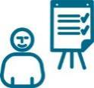
What we’ll talk about today
How your identity can be compromised.
Ways to protect your information.
What you can do if you experience identity theft or fraud.
Identity theft When someone steals your identity or personal information for illicit purposes.
Identity fraud When that person uses your stolen identity to commit fraud or illegally deceive someone.
Notes:
Here is what we’ll be talking about today.
How your Identity can be compromised.
Ways to protect your information.
What you can do if you experience identity theft or fraud.
There is a difference between Identify Theft and identity Fraud.
Identity theft is when someone steals your personal information or identity for illicit or illegal purposes. Information such as your Name, Address, Social Security or Tax ID number, Date of Birth, account number, or driver’s license number can be used to steal your identity.
Identity fraud is when the person who stole your information uses it to commit fraud or deceive someone. These can involve credit card fraud, opening a new account or taking over an existing account, applying for a job with your identity or stealing your tax refund.
These terms are now often used interchangeably since usually one happens with the other and can have significant impact to the victim.

Slide 3
Signs of identity theft or fraud
Notes:
Let’s review the signs of identity theft or fraud.

Slide 4
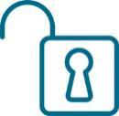
Watch out for fraudsters
Learn ways to protect your information
Social security number
Driver’s license/passport number
ATM/credit/debit cards
Personal information (date of birth, address, phone numbers)
Email (phishing and pharming)
Mail theft
Credit card fraud
Social networks
Malware
Data breaches
Notes:
It is critical that you protect your personal information. Your identity and money may be stolen if your personal information is compromised.
Your Social Security number, driver’s license, credit and debit cards, date of birth and so on can be used by fraudsters to access or takeover your accounts, or to create new accounts in your name for stealing your money or committing other acts of fraud.
According to the 2018 Javelin Fraud survey, account takeover tripled in the past year, with losses totaling more than $5 Billion.
Some of the ways fraudsters try to access your personal information include through phishing emails, mail theft, credit card fraud, social media, malware, data breaches or old-fashioned mail theft and dumpster diving.
Don’t forget to protect your kids’ information as well. According to Javelin, over 1 million children were ID theft victims in 2017.
We’ll go into more detail about a few of these on the following slides.

Slide 5
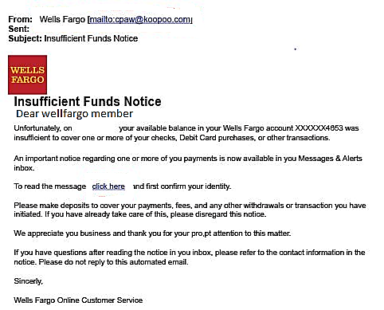
What’s wrong with this email?
Notes:
Let’s start with an example of an email that appears to be from Wells Fargo…or is it?
Look closely at this email – you can probably see it more clearly on your presentation handout.
What wrong with this email?
[Presenter – acknowledge raised hands one at a time and repeat the responses provided.]
[After all responses given…] Let’s take a look on the next slide for the signs of a suspicious email.

Slide 6
Signs of a phishing email
1
1. Strange/
unfamiliar links
2. Misspelled company name
2
3
1
3. Awkward greeting
4
3
5
4. Typos
6
4
5. Bad/awkward grammar
4
6. Urgent call to action
Notes:
Good guesses on some of the issues with this email! Be on the lookout for these warning signs of a phishing or scamming email:
Contains strange or unfamiliar links – DON’T CLICK ON THEM
Poor grammar, misspellings, typos, etc.
Unprofessional or awkward greeting
Urgent call to action – especially asking you to share your personal information, to send money somewhere, etc. - DON’T DO IT
Be aware that using unprotected email sites may make you vulnerable to email fraud.
If you send or receive any email with your personal information, you could open yourself up to fraud.
You should password protect or encrypt all documents sent to and from unprotected email sites. You can look up instructions on the internet that match with the type of operating system or device you use.

Slide 7
Ways that may help keep your mail safe
Have your name and address removed from the phone book (“unlisted”).
Install a lock on your mailbox.
Keep the envelopes containing bills you pay with checks in a secure place.
Carefully destroy/shred papers you throw out.
If you are away from home for an extended time.
Have the post office hold your mail, or
Ask a trusted person to pick it up for you.
TIP: Remove your name from the marketing lists of the three credit reporting bureaus by contacting 1-888-5OPTOUT (1-888-567-8688) or go to optoutprescreen.com.
Notes:
Here are ways that may help keep your snail mail safer:
[Presenter – review the bullets on the slide]
Be aware that some identity theft and fraud has been perpetrated by people who knew or met the victims and had access inside their house – like a family member/friend, cleaning/service people, etc. So it’s important to protect your documents inside your home as well.
TIP: You can also remove your name from the marketing lists at the three credit reporting agencies. You can either call or go online. This may help reduce the amount of unsolicited credit card and other solicitations you receive in the mail.

Slide 8
Keep your conversations secure
Don’t say, or let anyone say, your Social Security number out loud in a public place.
Keep sensitive information from prying eyes.
If you receive an unsolicited phone call asking for personal information, don’t give it, and listen closely to background noise.
Watch out for “shoulder surfers” who use binoculars, video or camera phones to capture information.
TIP: Sign up for the Federal Trade Commission’s (FTC) National Do Not Call Registry at donotcall.gov/ or call 1-888-382-1222 (TTY: 1-866-290-4236).
Notes:
Make sure you’re not sharing personal information in a public place or over the phone.
[Presenter – review the bullets on the slide]
TIP: You can register for the Do Not Call Registry maintained by the Federal Trade Commission, either by phone or at their website.
Cellphone and land line numbers can be registered.
If you call, you must call from the phone number you want to register.
If you register online, you must respond to a confirmation email from the FTC.

Slide 9
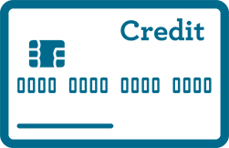
Check your knowledge
Card-not-present (CNP) transaction fraud decreased in 2017 due to EMV chip technology.
CNP => charges done over the phone or online.
Show of hands:
TRUE
FALSE
Source: Identity Fraud Survey Report, 2018, Javelin Strategy & Research.
Notes:
Let’s test your knowledge. Is this statement True of False? For credit card transactions, Card Not Present fraud decreased in 2017 due to EMV chip technology.
CNP transactions are when the card holder is charging their purchase remotely – either over the phone or online – not in person at the store.
Show of hands – [Presenter – count the number of hands raised out loud]
Who thinks this is a TRUE statement?
Who thinks this is a FALSE statement?
Let’s go to the next slide to see the answer.

Slide 10
FALSE!
Card-not-present (CNP) transaction fraud continues to increase since the implementation of EMV in the U.S.
POS
CNP
TIP: Use online and mobile tools to monitor your accounts. Offline consumers may take more than 40 days to detect fraud and incur higher fraud amounts than other fraud victims.
Sources: Identity Fraud Survey Report, 2018, Javelin Strategy & Research.
Notes:
This is a False statement.
Credit Card fraud using Card-Not-Present transactions continue to increase since EMV chip technology was fully implemented in October 2015.
EMV stands for Europay, MasterCard, Visa. The chip technology adopted in the United States for in-person, Point of Sale card transactions forced fraudsters to shift to using more remote fraud methods, like Card-Not-Present transaction theft.
This is why it’s important to set up online, mobile and text alerts on your checking and credit card accounts to monitor activity so you can quickly detect and stop unauthorized transactions to minimize your losses.
By the time a paper or online monthly statement has arrived, it may be too late to minimize your losses up that point.
In fact, offline consumers may take more than 40 days to detect fraud, and they incur higher fraud losses than other fraud victims.

Slide 11
Using caution on social networks
Be careful with what you choose to share and with whom. Fraudsters can use these sites to access addresses, dates of birth, even your mother’s maiden name or your daily schedule.
Do
Use privacy settings to control who can access your information.
Monitor what you post on your profile.
Accept friend requests only from people you know.
Use secured Wi-Fi networks.
Set your sign-on to use additional ID besides user name and password if you have the option.
Don’t
Post addresses, phone numbers or other identifying personal information.
Post anything you wouldn’t want publicized in the news.
Hang on to accounts you aren’t using anymore.
Advertise when you won’t be home.
Use unsecured, untrusted, open, or free Wi-Fi networks.
Source: 2018 “How to protect your identity on social media”, Business2Community, September 2018
Notes:
Social media can be a great way to stay connected with family and friends – and for fraudsters to get connected with you. This includes dating sites where “Romeos and Juliets” may be scammers out to get your money rather than your friendship.
Assume that any information posted on a social media site is not private.
Even “quizzes” on social media sites could be used for collecting personal information so be cautious about sharing any information online.
Here are some Do’s and Don’ts when it comes to internet use you should consider.
[Presenter – review the Do and Don’t columns on the slide]
Be sure not to use an open, free or unsecured Wi-Fi network if you are accessing your bank or credit card sites or keying in personal information that could be stolen by a hacker on that same open network.

Slide 12
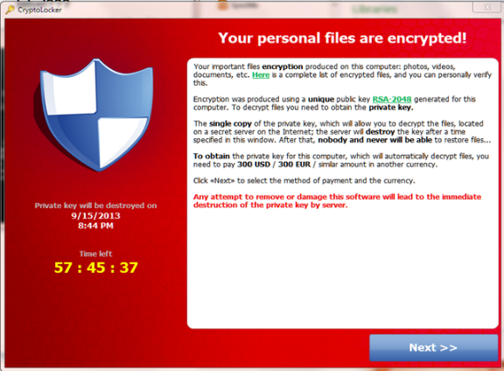
Malware can disrupt your computer or expose your information
Malware (Malicious Software) can get installed on your computer if you click on a link:
In a phishing email.
On an infected web ad.
With anything infected.
TIP: 71% of malware is delivered via phishing emails.
Symantec Internet Security Threat Report, duo.com, March 29, 2018
Notes:
Malware is Malicious Software that gets installed on your computer if you click on:
A link in a phishing email, like the one we just reviewed on the previous slide
A link in a web ad that is infected
Any link or email that is infected
Fraudsters may use these to:
Track your keystrokes to try to steal your user names and passwords and other information to access your accounts
Lock down your computer so it doesn’t work correctly
Take over your accounts through your computer
Send out emails under your name to attract your contacts like friends and families to become victims, too
TIP: A good rule of thumb is to not open any unfamiliar emails or links on the internet. Use appropriate anti-virus software that is updated frequently by the vendor to protect your computer.

Slide 13
Ways to protect your information
Notes:
Now let’s look at ways to protect your information.

Slide 14
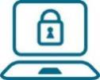
Defend yourself online
Shield your computer with firewalls and up-to-date software.
Keep personal information off social networking sites.
Ignore/delete emails urging you to click on a link to verify account information.
Create “tough-to-crack” passwords.
Don’t let financial programs or websites auto-save your passwords.
Connect to your financial accounts only from your own computer or using secure Wi-Fi locations.
Don’t use a debit card for online shopping – use a credit card.
Opt out of receiving unsolicited e-mails by registering at dmachoice.org. Click on “Register for eMPS”.
TIP: The “s” in the "https" web address indicates that your information will be encrypted (“secured”), making it harder for a thief to capture your information.
Notes:
As we have been discussing, you need to defend your personal information, and there are many ways for fraudsters to get it from online interactions.
[Presenter – review the slide and read the TIP]

Slide 15
General fraud prevention tips
Carry only necessary information in your wallet.
Make photocopies of vital information and store securely.
Only provide your Social Security Number or other personal information if absolutely necessary.
Lock all devices with a password.
Shred papers containing personal or financial information.
Promptly retrieve incoming mail from your home’s mailbox.
Place outgoing mail in a U.S. Postal Service mailbox.
Know your billing and statement cycles.
Don’t tell or key in over the phone your PIN or other information to someone calling you claiming to be your bank, etc.
TIP: Have your statements sent to you via email rather than mail (but don’t save financial/personal information in your email box).
Notes:
Here are some general fraud prevention tips you can use to avoid or minimize identity fraud from happening to you.
[Presenter – Review slide – and say these notes for the last 3 bullets]
Place outgoing mail in a U.S. Post Office mailbox - if you don’t have a secure postal mailbox at home or your neighborhood has had problems with “lost” or stolen mail, you may want to drop outgoing mail that contains personal information at a US Postal Service mailbox.
Know your billing and statement cycles - if you receive mailed statements and you think one is late in arriving, call to avoid missing a payment or learn if someone has compromised your account.
Don’t provide or key in your PIN over the phone – a recent scam is when someone calls you claiming to be your bank and that the bank has detected fraud on your debit card. They say you can change your PIN with them right now. They ask you to key in your current PIN into your phone, and then to key in your new PIN. The scammer has a device that records the beeps you make when you key in your current PIN to capture the numbers and they likely already have your debit card number so that’s all they need to commit fraud on your card!
[Presenter - Read TIP]
You can print your electronic statements and then delete them from their email inbox. And be sure to secure the printed statements, even in your home.

Slide 16
Data Security Breaches
In 2017, there were 1,293 data breaches compromising 174 million records, an increase of 45% over prior year – the highest ever.* Here are some actions you may consider taking:
Check your credit reports at annualcreditreport.com.
Place a credit freeze on your credit file with all three credit bureau agencies. And your kids, too.
Review the Federal Trade Commission’s (FTC) website consumer.ftc.gov.
Check out Wells Fargo’s Fraud Information Center at wellsfargo.com/privacy-security/fraud.
TIP: Set up mobile/email account alerts to be notified of withdrawals and deposits to your accounts, and any suspicious card activity.
*Identity Theft Resource Center, January 2018
Notes:
We have all heard about data security breaches in the news. The Equifax data breach was a big news item. But did you know that nearly 1,300 separate data breaches occurred in 2017! This was the highest number ever and experts expect these to continue to increase every year.
If you haven’t already done so, here are some steps you can take:
[Presenter - Reference and Summarize the slide]
Check your credit reports – you get one free report per agency per year
Consider placing a credit freeze on your credit file at each agency. Don’t forget your kids, too. Also you might want to discuss this idea with your senior family members as seniors are top targets for fraudsters.
Check out the FTC’s website for FAQs about protecting your information.
You can also go to Wells Fargo’s Fraud Information Center website for more information.
[Presenter - Read the TIP]
Set up text or email alerts to be notified of transactions in your accounts, when balances drop to a certain threshold, and credit card activity so you can catch possible fraud on your accounts as early as possible.

Slide 17
Check your credit status frequently
By law, you are guaranteed a free credit report annually from each of the three credit bureaus (Equifax, Experian and TransUnion).
Request a free copy of your credit report at least once a year at annualcreditreport.com. (Be careful - there are many look-alike sites which are not free of charge!)
Review your credit report carefully.
Report and resolve any errors quickly.
TIP: Stagger the timing of your requests from each of the three credit bureaus to help you track your credit history for free over the year.
Notes:
One of the ways you can protect yourself is to review your credit bureau reports each year. By law you are guaranteed a free annual credit report from each of the three credit reporting agencies – Equifax, Experian and TransUnion.
[Presenter – review the bullets on the slide and read TIP]
For regular monitoring, you can stagger the timing of your free credit report orders by requesting one report early in the year from one of the agencies, then order a report in the middle of year from the second agency, and lastly order a report later in the year from the third agency.
If you suspect an issue, we recommend you go ahead and request reports from all three bureaus at the same time just to be safe.

Slide 18
What if identity theft happens to you?
Notes:
Let’s review what you can do if you are a victim of identity theft or fraud.

Slide 19
If you experience identity theft or fraud
1
Close all accounts that you know or believe are tampered with
Call your creditors or financial institutions to notify them that your accounts may have been compromised.
2
Contact all three credit bureaus
Place an alert on your credit reports and review them for inaccuracies and unknown credit requests.
3
File a complaint with the Federal Trade Commission
Call 1-877-ID-THEFT (1-877-438-4338) or complete an Online Complaint Form at identitytheft.gov.
4
File a report with the local police
Provide a copy of your Online Complaint Form to add to the police report. (These documents can constitute an Identity Theft Report and entitle you to certain protections.) Make sure to keep a copy for yourself.
Notes:
If you experience identity theft or fraud, you need to act quickly. It may save you many hours of recovery work and worry in the future.
Be sure to follow these 4 steps: [Presenter - Reference slide]
Close your accounts and place a fraud alert on your profile at your bank
Contact all three credit bureaus to place alerts – we have their contact information on the next slide
File a complaint with the FTC
File a police report

Slide 20
Organizations to notify
Transunion
1-800-680-7289
transuznion.com
Experian
1-888-397-3742
experian.com
Equifax
1-800-525-6285
equifax.com
Passport fraud | United States Department of State travel.state.gov/passport
Mail fraud | Your local postal inspector
Social Security fraud | Social Security Administration Fraud Hotline (1-800-269-0271)
Tax fraud | IRS Identity Protection Specialized Unit (1-800-908-4490)
TIP: If you’ll be applying for credit, an apartment or a job, be sure to temporarily lift your credit freeze in advance to allow the creditor to check your credit history.
Notes:
Be aware that each credit reporting agency – TransUnion, Experian, and Equifax - reports separately and may have different information . If you suspect a problem, check all three bureaus to get a complete picture.
In addition to the three credit reporting bureaus , there may be other agencies you need to contact to protect your identity and money.
[Presenter - Reference and Summarize the slide]
[Presenter - Read the TIP]

Slide 21
Other ways to reduce the impact of theft
Service | What is it?
Credit Bureau monitoring | A paid service that monitors for suspicious activity or changes to your credit profile to detect potential fraud.
Fraud alert | A message placed on your credit report, requiring lenders and creditors to confirm your identity before issuing a new line of credit, granting an increase in credit limit on an existing credit account or issuing an additional card on an existing credit account. May stop someone from opening new credit accounts in your name, but may not prevent misuse of your existing accounts.
Credit freeze | Locks down your credit file at the credit reporting agencies so they can’t issue credit history to any lender, creditor, etc. Prevents fraudulent new accounts from being opened in your name.
Public data scanning | Scans public records and Internet sites for your personal or financial information. Detects potential identity theft. (Your information may or may not have been misused for financial gain…yet.)
Notes:
Here are some specific actions you can take related to your credit report with each of the credit agencies that you may want to consider.
[Presenter - Reference and summarize the slide]

Slide 22
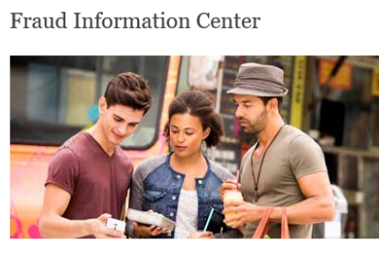
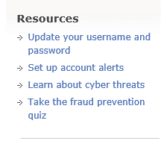
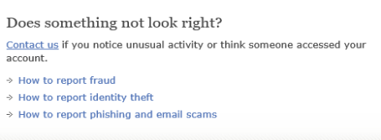
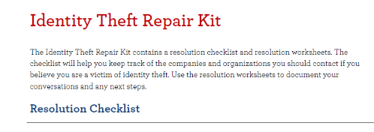
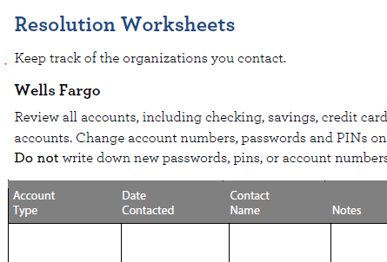
Wells Fargo resources
Wells Fargo Fraud Information Center - tips and articles on how to protect yourself
wellsfargo.com/privacy-security/fraud
Wells Fargo Identity Theft Repair Kit - can help organize your response to fraud
wellsfargo.com/privacy-security/fraud/repair-kit
Notes:
Wells Fargo offers resources to help with ways to protect yourself from identity theft and fraud, and what to do if it happens.
The Wells Fargo Fraud Information Center provides tips and articles on how to protect yourself, and includes information on known scams.
The Wells Fargo Identity Theft Repair Kit can be printed off to help you get organized on how to recover from your identity being stolen or used in a fraudulent incident.

Slide 23
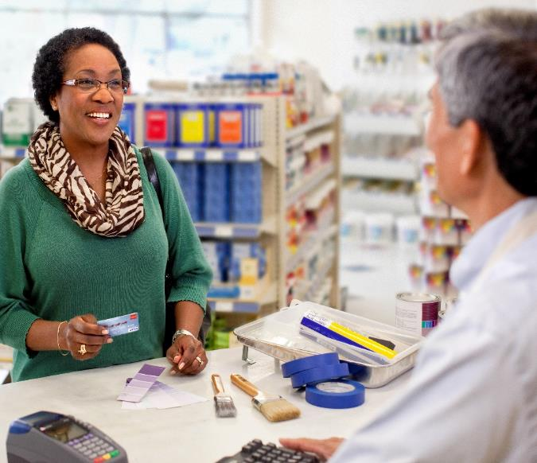
Thank you
…for participating in today’s workshop!
Please complete the evaluation form to provide feedback on how we can improve our presentation.
Notes:
[TIME PERMITTING] Are there any other questions?
Thank you for coming today! I appreciate you taking the time to learn about some ways and resources to help protect your financial information.
I would like to get your feedback to help us improve this workshop. Please take a minute to complete the evaluation form.
[Presenter - Give attendees instructions on where to place the completed forms – on their chairs, on a back table, give to you, etc.]
[TIME PERMITTING] I’ll be here for a few minutes if you’d like to ask me questions individually. Thank you again!
22

