Slide 1
Racial Equity and Homelessness in Pierce County: Beginning A Conversation
Pierce County Coalition to End Homelessness
Subgroup On Racial Equity
October 18, 2019

Slide 2
Agenda
Racism and Homelessness –
Ground Rules
Framing the Conversation
Breakout Groups –
Conversation around three discussion prompts
Identify a reporter to report out to the group
Report Outs
Wrap Up – Ideas for Next Steps

Slide 3
Ground Rules
Make this room a safe place for this discussion.
Trust – the room is full of people who care and are doing their best. Leave discussions here.
Recognize your inherent biases, acknowledge that you may have been taught misinformation.
Do not blame yourself or others for being wrong.
Calling in vs. Calling out – be open to learning moments.
Try not to generalize – use “I,” instead of “they,” “we,” and “you”.
Share the air – don’t dominate the conversation, don’t speak over people of color.
Ask for help – if you genuinely need clarification, we can talk it out as a group.

Slide 4
Inequities and Race:
Although Black people comprise 13% of the US population and 26% of those living in poverty, they account for more than 40% of the overall US homeless population.
Black men remain homeless longer than White or Hispanic men.
In SPARC communities, homelessness among American Indian/Alaskan Native was 3 to 8 times higher than their proportion of the general population.
In Pierce County, Black and American Indian or Alaska Native had the highest rates of double homeless occurrences (20.0% and 24.1%, respectively).
See the 2018 SPARC report for national and local data and analysis:
https://www.piercecountywa.org/DocumentCenter/View/67289/SPARC-Tacoma---Pierce-County- Report-February-2018?bidId=

Slide 5
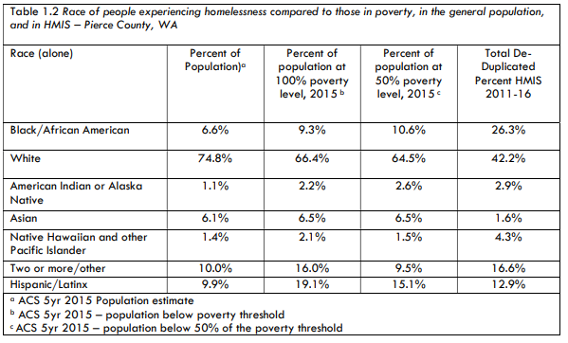
Overrepresented by 4x
Overrepresented by 3x

Slide 6
Systemic Racism and Disparities Affecting Housing and Homelessness:
These are profound issues. But, today we are focused on HOMELESSNESS AND HOUSING ISSUES.
Wealth Disparities
Educational Disparities
Criminal Justice Disparities
Employment Disparities
Healthcare/Access to Healthcare

Slide 7
Today’s Plan:
We will breakup into small discussion groups.
We will share short reports about key themes.
We will share some thoughts about next steps.

Slide 8
Questions for Small Group Discussion - Causes
What factors seem to contribute to your clients of color becoming homeless?
What barriers do your clients of color particularly face in finding and keeping a stable place to live?
What unfair institutions or policies create hardships for people of color experiencing homelessness?

Slide 9
Questions for Small Group Discussion - Solutions
In what ways does your organization seek to address the particular needs of clients of color?
What has been successful?
Has anything failed in the past?
What strategies, resources, or actions do you think might help to reduce inequities?
What actions do you think the Coalition might take?

Slide 10
Reporting Back and Moving Forward
Group reports – key themes about causes and solutions
What strategies, resources, or actions are needed?
What actions do you think the Coalition might take?

Slide 11
Move into Groups!

Slide 12
Next Steps
Join the racial equity subcommittee.
Future coalition session:
Summary of notes from today
Hearing more about lived experienced
Coordinating with other equity efforts
What can we do NOW (individually and collectively)?

