Slide 2
Outpatient Services
Co-Occurring Outpatient Services
Substance Use Disorder Outpatient Services
Supportive Employment Services
Housing Assistance
Energy Assistance
Education Opportunity Center (EOC)

Slide 3
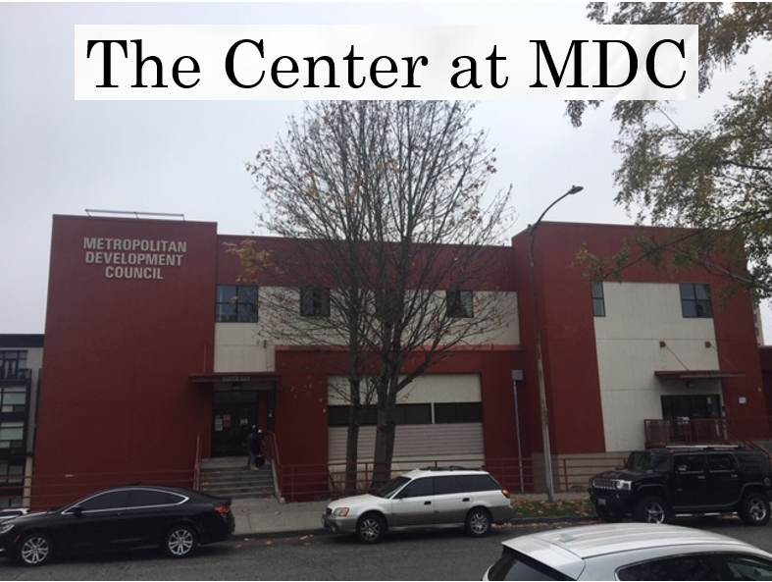
Notes:
Solid organizational structure that reflects CEO’s vision for MDC as a pere-eminent Community Action Agency

Slide 4
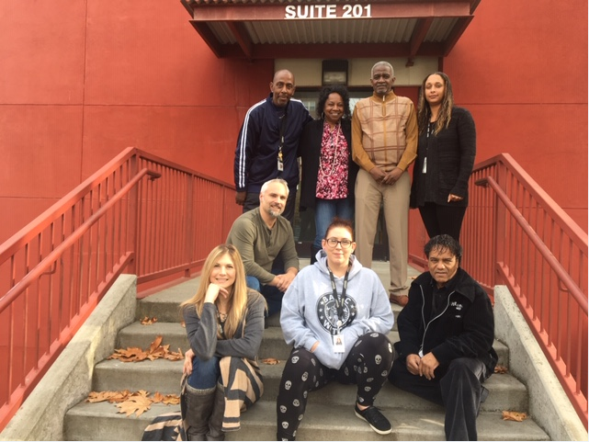
The Center

Slide 5
Co-Occurring Outpatient Services
COD Treatment at The Center
COD Treatment at Nativity House
Thank you Catholic Community Services!
Thank you City of Tacoma!

Slide 6
Substance Use Disorder Outpatient Services
Assessment, referral & placement
Level one and two outpatient services

Slide 7
Substance Use Disorder Outpatient Services

Slide 8
Recovery Coach
“Never give up.”- Paul Bruce

Slide 9
Recovery Coach
“You can do this.” -Vernell Hennings

Slide 10
COD/Supported Employment
Overview
Created by HCA/FCS and Medicaid.
Working with Amerigroup and other service providers.
This program has until 2021 to prove with support individuals with significant barriers to employment can stabilize their lives.
Client Requirements
Medicaid funded &
Significant Barriers in:
Mental Health
Substance abuse
Traumatic brain injury
Incarceration
Clients desire to work

Slide 11
Supported Employment Process
Initial Intake
FCS approval… 5-days
Formal intake
Career assessment
Job plan
Resume building
Intensive job search
Client meetings
The Formal Intake requires several hours and takes place over 3 – 4 meetings.
Using motivational interviewing techniques we develop strong relationships and begin learning what each person’s skills and barriers to employment are. We develop a plan to overcome those barriers when seeking employment.

Slide 12
COD/Supported Employment
ADDITIONAL SUPPORTS…
Clients may require additional supports that are considered barriers to employment
Work with MHP/CDPs/Caseworkers to address anxiety based difficulties
Provide Interview Clothing
Bus Passes
Phone Services
Ongoing “follow along” supports after employment
Provide resources for Housing, Mental Health, SUD, and other concerns

Slide 13
Team MDC
James Oliver, MHA, MHP, CDP
Outpatient Program Manager
Office: 253-284-9005
joliver@mdc-hope.org
Shannon Hayes COD/Supported Employment Specialist
Office: 253-284-7811
Cell: 253-278-6693
shayes@mdc-hope.org
Paul Bruce Recovery Coach/Life Changer
Office: 253-284-7808
pbruce@mdc-hope.org
Vernell Hennings Recovery Coach/Life Changer
Office: 253-284-9046
vhennings@mdc-hope.org

Slide 14
Thank You

