Slide 1
Wellness for Emergency Workers
Recommendations for Volunteers, First Responders, Health Workers and EOC Staff
Ivan Tudela
Unified Command
Elizabeth Allen
eallen@tpchd.org
Tacoma Pierce County Health Department
March 31, 2020
Notes:
Sources for this presentation come from the following:
CDC
SAMHSA
Pacific Southwest ATTC (Addiction Technology Transfer Center)

Slide 2
Stay healthy
Manage workforce stress.
Prevent compassion fatigue.
Create self-care plans.
Notes:
During and after a disaster, it is natural to experience different and strong emotions. Coping with these feelings and getting help when you need it will help you, your family, and your community recover from a disaster. Connect with family, friends, and others in your community. Take care of yourself and each other, and know when and how to seek help.

Slide 3
Learn how to prevent and manage workplace stress and compassion fatigue
What’s the difference between burnout, compassion fatigue and secondary traumatic stress (STS)?
Burnout
Extreme exhaustion and being overwhelmed.
Easily angered, frustrated, irritable.
Lack of feelings.
Notes:
Feeling like:
A failure
Nothing you can do will help
You are not doing your job well
You need alcohol/other drugs to cope

Slide 4
Compassion fatigue
Emotional stress from working with people exposed to a traumatic event and is different from “burnout.”
Nervous system arousal (Sleep disturbance).
Emotional intensity increases.
Behavior and judgment impaired.
Loss of morale.
Depression.

Slide 5
Secondary Traumatic Stress
Stress from helping or wanting to help a traumatized or suffering person.
Intrusive imagery.
Avoidance of reminders and cues.
Hyperarousal.
Distressing emotions.
Functional impairment.
Notes:
According to Bride et al. (2007), with the exception that the traumatic exposure is indirect, secondary traumatic stress is nearly identical to posttraumatic stress, including symptoms associated with PTSD.
Excessively worry or fear about something bad happening
Easily startled, or “on guard” all of the time
Physical signs of stress (e.g. racing heart)
Nightmares or recurrent thoughts about the traumatic situation
The feeling that others’ trauma is yours

Slide 6
Taking care of YOU
If possible, limit working to no longer than 12-hour shifts.
Work in virtual teams; limit amount of time working alone.
Talk to family, friends, supervisors and teammates about your feelings and experiences.
Practice breathing and relaxation techniques.
Know that it is okay to draw boundaries and say “no” to prevent burnout, compassion fatigue or STS.

Slide 7
Use the buddy system
A team member shares in the responsibility for their partner’s safety and well-being.
Do:
Be a listener to your buddy.
Monitor your buddy for stress (including environmental stressors).
Check on your buddy’s workload and encourage breaks when needed.
Notes:
Set up times to check-in with each other. Listen carefully and share experiences and feelings. Acknowledge tough situations and recognize accomplishments, even small ones.
Offer to help with basic needs such as sharing supplies and transportation.
Monitor each other’s workloads. Encourage each other to take breaks. Share opportunities for stress relief (rest, routine sleep, exercise, and deep breathing).
Communicate your buddy’s basic needs and limits to leadership – make your buddy feel “safe” to speak up.

Slide 8
Use the buddy system
A team member shares in the responsibility for their partner’s safety and well-being.
Do Not:
• Offer clinical diagnosis or treatment.
• Take on the role of a therapist.
• Pry or demand that a buddy discuss problems.

Slide 9
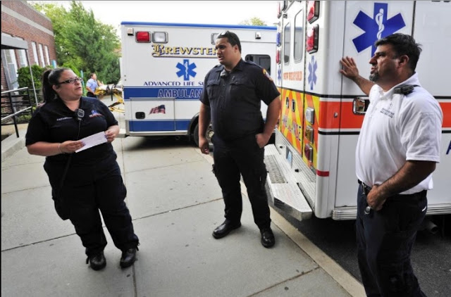
Remember these points
It is not selfish to take breaks.
The needs of survivors are not more important than your own needs and well-being.
Working all the time does not mean you will make your best contribution.
There are other people who can help in the response.

Slide 10
Resources for you, staff and volunteers
For non life-threatening but urgent mental health crisis:
Pierce County Crisis Line (24/7) 1-800-576-7764.
Crisis Text Line text 741741 (mobile fees waived).
Other mental health resources, call 211.
LGBTQ Trevor Project Support Center 866-488-7386.

Slide 11
Resources for you, staff and volunteers
If you or someone you know has suicidal thoughts:
National Suicide Prevention Lifeline(24/7) 1-800-273-TALK (8255).

Slide 12
Online resources
Traumatic Incident Stress (CDC National Institute for Occupational Safety and Health [NIOSH])
Interim NIOSH Training for Emergency Responders: Reducing Risks Associated with Long Work Hours (CDC NIOSH)
Resilience Resources for Emergency Response (Occupational Safety and Health Administration)
Psychological First Aid for First Responders (SAMHSA)

Slide 13
Online resources
Guidelines for Good Practice: Managing Stress in Humanitarian Workers (Antares Foundation)
Stress and Coping During Coronavirus (CDC)
Emergency Responder Wellness (CDC)
Compassion Fatigue (American Institute of Stress)

