Slide 1
Strategies & Considerations for a Racial Equity Response to COVID-19
Klarissa Monteros
Senior Manager, Grantmaking & Capacity Building
Katara Jordan
Senior Manager, Policy & Advocacy

Slide 2
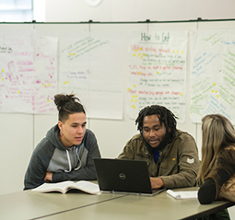
Diversion is a creative, person-centered, problem-solving approach. Through Diversion, a counselor or other provider builds upon a student or family’s strengths to help them solve their own housing crisis by finding permanent housing solutions outside of the mainstream crisis response system.

Slide 3
Student Homelessness: Nighttime Residence

Slide 4
Student Homelessness: Race/Ethnicity
but students of color only represent 46% of the total student population.

Slide 5
Strategies
Expand Diversion
Be inclusive of those experiencing Category 3 homelessness.
Replace doubled-up with short term hotel stays as a viable alternative.
Use already established infrastructure to keep students and families in their homes by providing mediation, negotiation and flexible funding.
If there is interest, we can create a free training resource.
Provide direct cash transfers to youth and families.
Targeted outreach and workshops to build awareness in communities of color, immigrants, refugees, tribal and/or rural regions.

