Slide 1
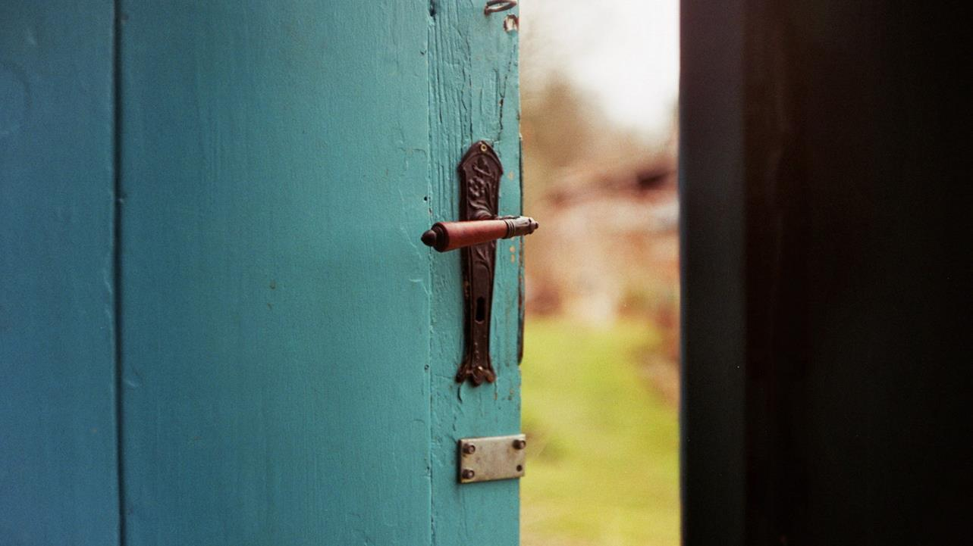
Proposal for Ending Chronic Homelessness in King County
May 2020

Slide 2
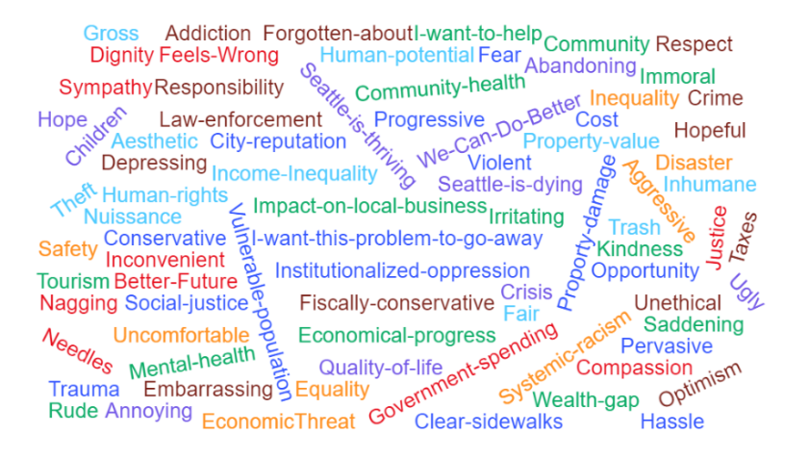
We Don’t Have to Share the Same Reasons for Caring about this Issue to Solve It
Property-damage

Slide 3
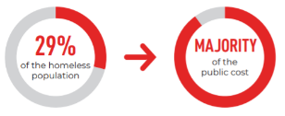
6,500 people in King County are Chronically Homeless
Visible and Vulnerable:
Exposed on the street
Suffer from higher rates of poor health, mental illness, and substance abuse
The Most Costly:
Emergency services
Hospitalization
Police services
Court
Probation resources
Time spent in correctional facilities

Slide 4
A Proven Solution to End Chronic Homelessness
Permanent Supportive Housing
Permanent
Tenants can live there as long they want – it’s not a temporary shelter. Most stay for the rest of their lives.
Supportive
Tenants are provided robust, voluntary services aimed at housing retention and achieving life goals.
Housing
Tenants sign leases and contribute up to 30% of their income for their apartments, the same place they return to every day.

Slide 5
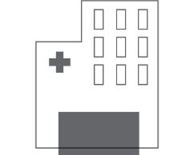
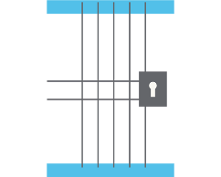
It Costs The Same to Provide
=
=
3 Days
at Harborview
3 Months
in a King County Jail
One Year
of Permanent Supportive Housing

Slide 6
A Way to Create 6,500 Permanent Supportive Homes with $1.676 billion in King County
Additionally, $175 million to come from permanent annual levies to pay for annual operating and service costs
WA State
Business
Leaders
King County
Cities

Slide 7
Next…
Go to thirddoorcoalition.org
Sign letter in support
Follow us on social media
Twitter @thirddoorsea
Facebook
Engage
Strategy sessions to operationalize the framework
Public Q&A
Ambassador training program

