Slide 1
CDC Guidance - Unsheltered
Unless individual housing units are available, do not clear encampments during community spread of COVID-19.
Encourage spacing of tents.
Ensure nearby restroom facilities have functional water taps, are stocked with hand hygiene materials (soap, drying materials) and bath tissue, and remain open to people experiencing homelessness 24 hours per day.
If toilets or handwashing facilities are not available nearby, provide access to portable latrines with handwashing facilities for encampments of more than 10 people.
https://www.cdc.gov/coronavirus/2019-ncov/community/homeless-shelters/plan-prepare-respond.html

Slide 2
Updated Guidance: Unsheltered Homelessness
Issued May 10th
Communication is key
If individual housing options are not available, allow people who are living unsheltered or in encampments to remain where they are.
Clearing encampments can cause people to disperse throughout the community and break connections with service providers. This increases the potential for infectious disease spread.
Tents spaced at least 12 feet x 12 feet of space per individual
Individual rooms or safe shelter for people with higher risk
Improve sanitation access
Accessible 24 hours per day

Slide 3
CDC Guidance - Sheltered
Shelters should not close or exclude people who are having symptoms or test positive for COVID-19 without a plan for where these clients can safely access services and stay.
Depending on resources and staff availability, non-group housing options (such as hotels/motels) that have individual rooms should be considered for the overflow, quarantine, and protective housing sites.
In addition, plan for how to connect clients to housing opportunities after they have completed their stay in these temporary sites.
https://www.cdc.gov/coronavirus/2019-ncov/community/homeless-shelters/plan-prepare-respond.html

Slide 4
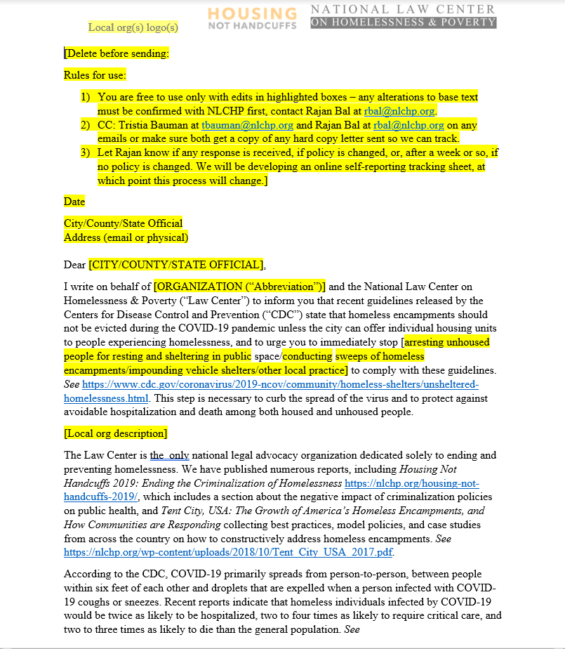
Take action!

