Slide 1
Tacomaprobono Community Lawyers Housing Justice Project
Presentation to
Pierce County coalition to End homelessness
August 20, 2021

Slide 2
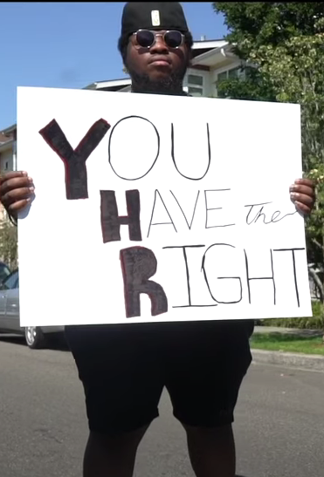
Eviction Resolution Pilot Program – ERPP
The ERPP is a program authorized by the Pierce County Superior Court to help divert evictions for nonpayment of rent by helping steer tenants to rental assistance and work out repayment plans to avoid eviction.
A portion of the ERPP process involves the tenant having legal representation.
What does this mean?
Tenants have rights!

Slide 3
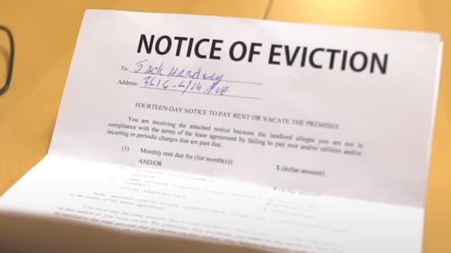
The ERPP and Evictions for Nonpayment of Past Rent During the Moratorium Period March 1, 2020 – July 31, 2021
Evictions due to non-payment of rent from March 1, 2020, through September 30, 2021, should not happen IF the landlord and tenant follow the steps outlined in the ERPP.
“If based in whole or in part” on nonpayment during the moratoria, landlords are prohibited from serving or threatening to serve any notice requiring the tenant to vacate—pay-or-vacate, summons or complaint, termination of tenancy, comply or vacate UNTIL PROPER PROCEDURES ARE FOLLOWED.

Slide 4
The landlord must offer a reasonable repayment plan
If a tenant is behind on rent, the landlord can refuse partial payment, but MUST offer a “reasonable” repayment plan.
The payments cannot exceed 1/3 of the monthly rent and will begin 30 days later.
If the landlord offers a repayment plan, the tenant must RESPOND within 14 days.
Respond does not mean accept
The tenant does NOT have to accept the offer
If the tenant does accept the offer and defaults, or refuses the offer, the landlord MUST advise the tenant of the ERPP before filing an unlawful detainer (eviction notice).

Slide 5
The landlord must provide the tenant with resources
The landlord MUST also provide the tenant with funding resources and programs.
The notice can be delivered to the tenant in hard copy or electronically
The tenant can begin the process by completing this form: ERPP Notice and Resource Information. This form is to be used after the eviction moratorium ends.
https://agportal-s3bucket.s3.amazonaws.com/uploadedfiles/Another/Safeguarding_Consumers/Eviction%20Form.pdf

Slide 6
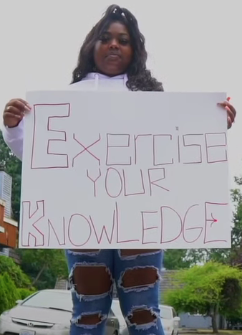
If the tenant and landlord cannot come to an agreement regarding repayment, the tenant has options:
Apply for Rental Assistance
Contact the Center for Dialog & Resolution

Slide 7
Tenants were expected to begin paying rent again on August 1, 2021.
A landlord is STILL “prohibited from serving or enforcing, or threatening to serve and enforce, any notice requiring the tenant to vacate . . . including . . . notice to pay or vacate, unlawful detainer summons or complaint, notice of termination of rental, or notice to comply or vacate” IF:
1) The tenant paid rent in full, OR
2) The tenant made a partial payment based on their individual economic circumstances as negotiated with the landlord, OR
3) The tenant has a pending, unprocessed application for rental assistance.

Slide 8
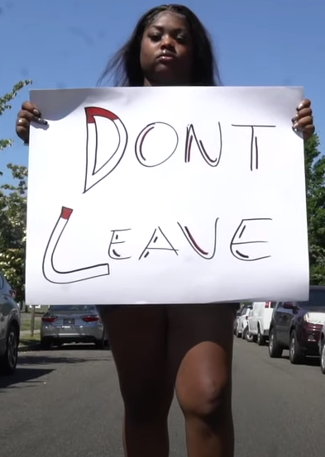
If you apply for rental assistance, STAY WHERE YOU ARE. The landlord cannot evict you once the process has started. It is in everyone’s best interest for you to remain.
If you leave, you will not be able to take advantage of rental assistance.

Slide 9
The Center for Dialog & Resolution – Dispute Resolution Center (DRC)
Anyone can contact the Center for Dialog & Resolution to get the conversation started, whether it is working out an affordable repayment plan, or connecting the tenant to other services such as rental assistance or rehousing.
The DRC will reach out to everyone involved. A certificate regarding outcome of mediation will be issued upon completion of the mediation process.
Call: 253-572-3657
Email: SolveIt@CenterForResolution.org
https://centerforresolution.org/mediation-services/eviction-resolution-program

Slide 10
Speed bump to court

Slide 11
Eviction Resolution Pilot Program
Resolve BEFORE filing at court.

Slide 12
Eviction Resolution: DRC Role
Rental assistance + Legal council + Conversation
Certificate before filing

Slide 13
We listen...

Slide 14
Dialog Service Options
Intake website form & conversation
Conciliation: short phone sessions with impartial mediator to finalize payment plan & communications
Conflict coaching: individual session with a mediator to help you prepare for meeting with Landlord.
Mediation (Meet & Confer mediation) with landlord & tenant (all attorney present)

Slide 15
Successful ERPP Mediation
Provide predictability and consistency
in the ERRP mediation process which
allows all to hold a unique and productive conversation in every instance.

Slide 16
How to prepare for conversation
Reflect on your situation (goals & impact)
Consult legal for rights and interests
Be willing to listen & learn to other side (goal & impact)
Recognize both are impacted and making a plan going forward: options & creativity.
Deep breaths help you to stay present in the conversation.

Slide 17
HOW TO GET HELP!
For more information and help in Pierce County, contact Tacomaprobono Community Lawyers Housing Justice Project:
Online intake at https://www.tacomaprobono.org
Email us at hjp@tacomaprobono.org
Voicemail (253) 572-5134

Slide 18
We’ve got your back.
https://www.youtube.com/watch?v=NZbX35lJRs8

