Slide 1

LASA is a community supported agency committed to both the prevention of homelessness and recurrent homelessness
We are about: Living, Access, Support, and Alliance

Slide 2
Pierce County Housing Crisis
One-third of households in Pierce County are housing cost burdened (100,000 households)
  More the 30% of their income goes to housing.
  43,000 households spend more than 50% of their income on housing.
During the past decade, the county added between 13,000 and 20,000 fewer housing units than it needed to meet all housing needs.
  This is the main reason for skyrocketing housing costs.
Pierce County needs to build 2300 affordable units a year through 2044 to meet the housing need.
THIS IS THE MAIN REASON FOR HIGH HOUSING COSTS AND HOMELESSNESS IN PIERCE COUNTY

Slide 3

City of Lakewood Comprehensive Plan
9378
New living units by 2044
  469 Units needed every year.
574
Emergency Housing Units

Slide 4

City of Lakewood
Average Home Cost
  $500,017
Average Rent Cost
  Studio - $1,299
  1-bedroom - $1,482
  2-bedroom - $1,745
  3-bedroom - $2,200

Slide 5
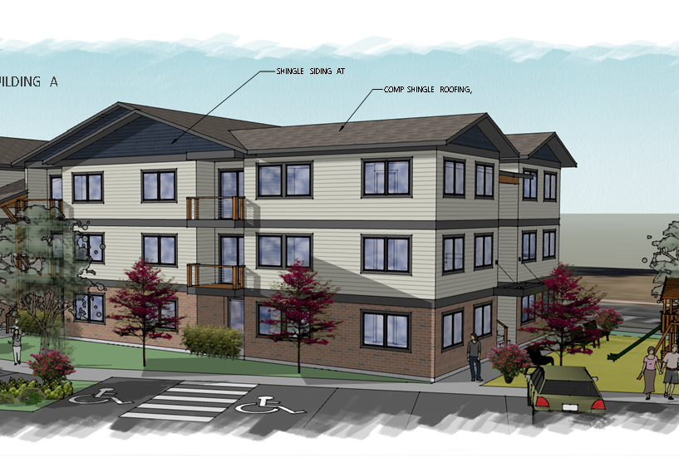
Gravelly Lake Commons
  Cost
  $12.5 million, give or take
  Raised $13.1 Million
  State of Washington $5.5 million
  Pierce County $3.5 million
  City of Lakewood $3.1 million
  Federal Government $1 million

Slide 6
Gravelly Lake Commons
26 Units of Affordable Housing
6 - 2 Bedroom units - $816
10 - 2 Bedroom units - $1360
3 - 3 Bedroom units - $942
7 - 3 Bedroom units - $1570
    Washer/Dryer in 3 Bedrooms
4 ADA units

Slide 7
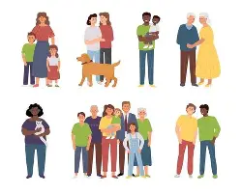
Who is Eligible
Families who earn less than 50% AMI
30% or below – 9 units
  6 – 2 Bedrooms
  3 – 3 Bedrooms
30% - 50% - 17 units
  10 – 2 Bedrooms
  7 – 3 Bedrooms

Slide 8
Area Median Income
Tacoma/Pierce County Median Family Income: $120,800
Persons in Family | 1 | 2 | 3 | 4 | 5 | 6
Extremely Low Income(30%) | $25,400 | $29,000 | $32,650 | $36,250 | $39,150 | $43,150
Very Low Income (50%) | $42,300 | $48,350 | $54,400 | $60,400 | $65,250 | $70,100

Slide 9
Priorities
Households with children.
Households who have had experienced homelessness.
Connected to City of Lakewood or Unincorporated Pierce County

Slide 10
How to get Connected
Basic Applications will be available in Mid-June
LASA Website: www.lasapierce.org
Paper copies at LASA office (Or print them out)
Applications Ask:
Income
Family Size
Rental History
Criminal Background

Slide 11
Process
All who qualify (based on income) go on the waitlist.
  First come first serve based on household size and unit size available.
Final Decision will be based on:
  Eligibility/Priorities
  Rental history
  Background check

Slide 12
Process
Sign Lease
Pay move in costs
Move in
All households can live in units as long as they want if they are good residents.
  Rent will adjust as their income grows or changes.

Slide 13
Questions?
What else do you want to know?
www.lasapierce.org
(253) 581-8689
8956 Gravelly Lake Dr. SW Lakewood, WA 98499

