Slide 1
Shared Housing
Associated Ministries
Notes:
1
Always use as first slide

Slide 2
About Associated Ministries
Associated Ministries is an interfaith organization​ working together toward lasting solutions to homelessness. Our programs help individuals and families manage crises, secure stability, and build assets.​
​
​
​
​
Notes:
Always use as third slide

Slide 3
Adult Home Share (AHS)
Adult Home Sharing is a living arrangement where Home Providers offer accommodations to Home Seekers in exchange for an agreed-upon level of support in the form of financial contribution, assistance with household tasks, and companionship.
Notes:
In times of disaster, people will turn to faith groups for help and support. We want to help you prepare for this.
We provide quarterly trainings at different locations in Pierce County.
Skills learned can be used in any caregiving situation.

Slide 4
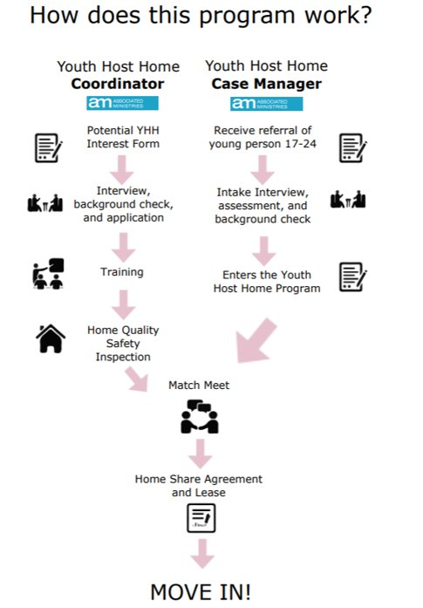
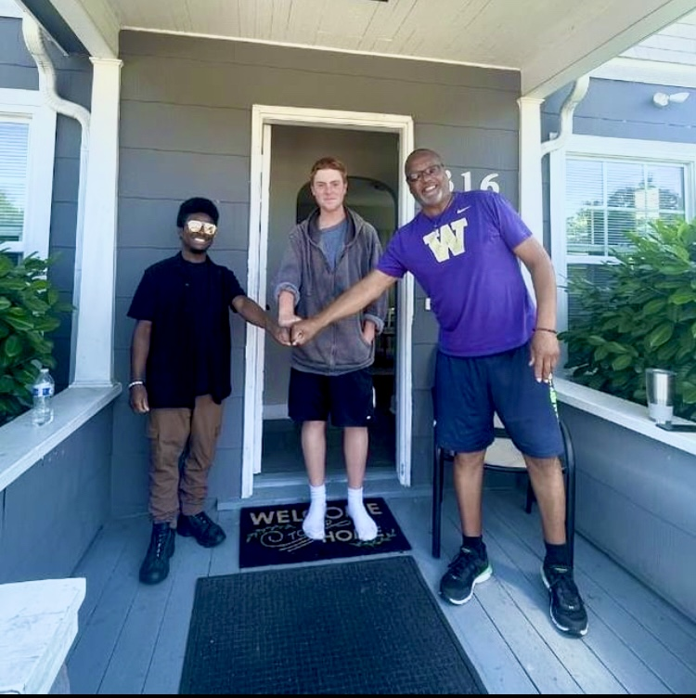
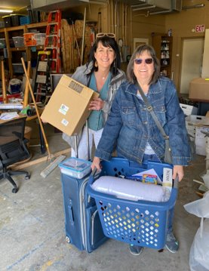
Youth Host Homes (YHH)
Youth Host Homes is a program that pairs a young person experiencing homelessness with a caring household wanting to make a difference.
Notes:
Use this slide style (orange top, white bottom) to present the items you mentioned you would be discussion during this section of the presentation.

Slide 5
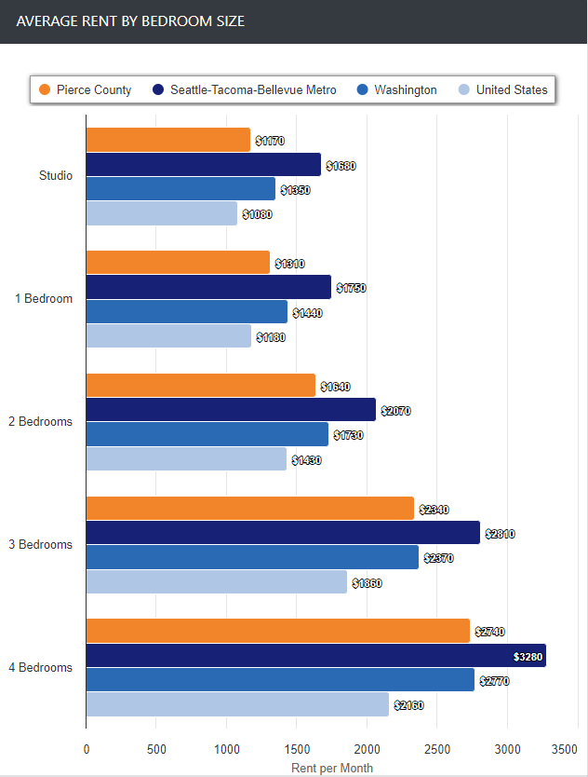
Shared Housing: Outreach
Empty rooms change lives. There is affordable housing using the space we already have in Pierce County.
This chart shows the increased cost of housing in King and Pierce County compared to the US average. Notice the difference expanding in price for homes with multiple rooms.
When we use strategic methods of outreach and marketing, we can identify spare rooms to house those in need of shelter while financially supporting those burdened with a home they can no longer afford.
Community Outreach
Marketing Campaigns
Match Making Events
Volunteer Programs
Notes:
Always use as third slide

Slide 6
Thank You!
Reach out to us to set up a meeting or presentation today!
We'd love to talk with you.
Annika Fraga
Community Outreach Lead
Annikaf@AssociatedMinistries.org
Jessie Thompson
Community Programs Manager
JessieT@AssociatedMinistries.org
Follow us on Facebook and Instagram @associatedministries
Notes:
Always use as third slide

