Slide 1
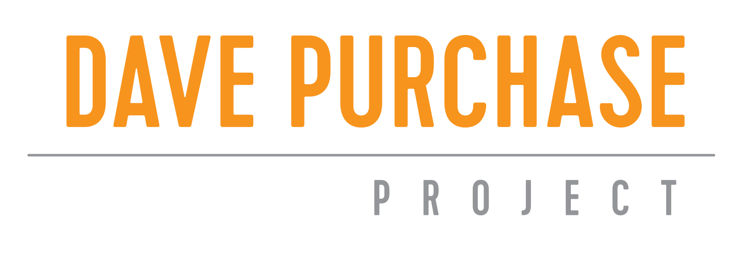
Overdose Response and Naloxone Training
Tacoma Needle Exchange

Slide 2
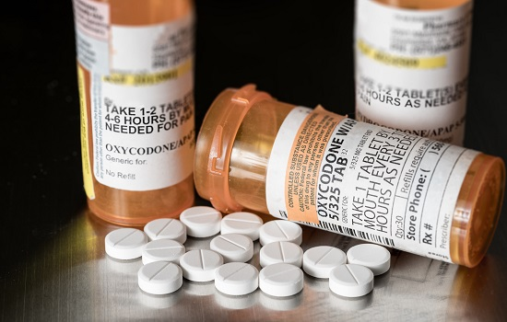
What are Opioids
Natural occurring opiates or synthetic opioids bind to specific receptors in the brain, spinal cord, and other parts of the body and reduce the transmission of pain signals
Opioids:
Heroin
Morphine
Vicodin
OxyContin
Percocet
Codeine
Fentanyl
Methadone
& more
NOT Opioids:
Cocaine/crack
Methamphetamine
Benzodiazepines:
Xanax
Ativan
Klonopin
Valium
Muscle Relaxers
Alcohol

Slide 3
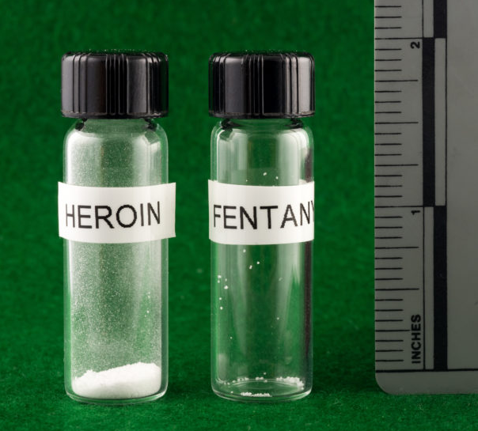
Fentanyl
A highly potent, fast acting synthetic opioid
Fentanyl is 50-100 times> Morphine, 30-50 times> Heroin
Non-pharmaceutical fentanyl can be found in other illicit drugs such as: cocaine, crack, methamphetamine, MDMA, ketamine, and other street drugs that are sometimes pressed into pills.
There is no risk of an overdose by touching fentanyl

Slide 4
Risk Factors for Overdose
Tolerance
Mixing
Quality
Using alone
Previous overdose
Illnesses that weaken the heart or make breathing more difficult
Harm Reduction Strategies
Start slow and use less
Change route (from IV to smoking or oral)
Mixing with other drugs or alcohol will intensify. Use one at a time. Use less of each drug if mixing
Buy from people you know, ask if any changes have been made
Use The Brave App https://www.thebraveapp.com/ call Never Use Alone
800-484-3731 or use with someone you know and take turns
Notes:
Using opioids again after your tolerance has dropped (e.g., like after being in treatment, a hospital, or jail). After a break from opioids, the body can’t handle as much as it did before.
Taking prescription pain medication more often or in higher doses than prescribed-or using someone else’s prescription pain medication. The dose could be too much.
Using heroin or pills bought on the street. Heroin and street pills often contain other substances that can be dangerously toxic.
Using opioids with alcohol or other drugs including sleeping pills, benzodiazepines (“benzos” like Valium and Xanax), cocaine and methamphetamine.
Any current or chronic illness that weakens the heart or makes it harder to breathe.
Using opioids alone. You are more likely to die from an overdose if no one is there to help.
Previous overdose. A person who has overdosed before is more likely to overdose again.

Slide 5
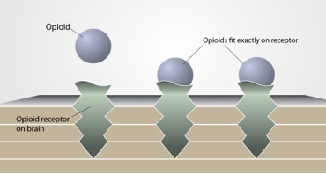
What is an Opioid Overdose
An overdose (or drug poisoning) happens when a toxic amount of an opioid or a combination of drugs overwhelms the body
Breathing is slowed and then stopped
Can happen in minutes to hours after the drug is used
Survival depends on breathing and oxygen
Within 3-5 minutes without oxygen, brain damage can occur, and other vital organs eventually stop
There is time to respond – but no time to waste
Notes:
Overdose (or opioid poisoning) happens when there is a toxic amount of a drug or combination of drugs and it overwhelms the body.

Slide 6
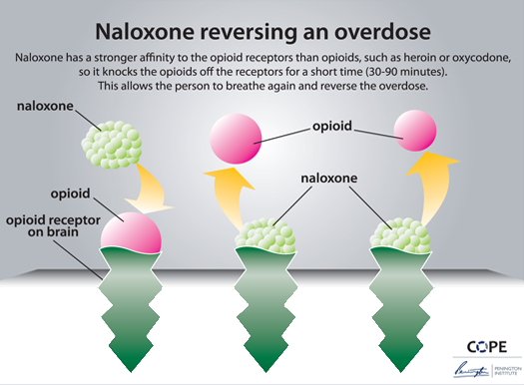
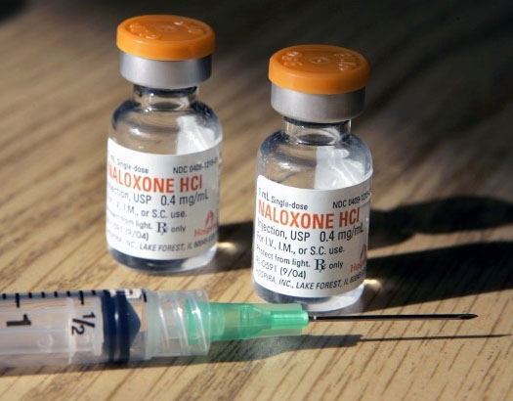
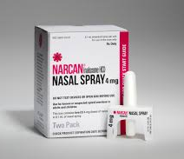
What is Naloxone?
AKA Narcan (name brand)
Medication that reverses opioid overdose and restores breathing
No potential for misuse or dependency
Will not harm you if not overdosing
Naloxone has a strong affinity to opioid receptors and temporarily blocks opioids
Starts to wear off in 30-90 minutes
Notes:
Naloxone, brand name Narcan
Although people can overdose on lots of things, Narcan is only for an opioid overdose

Slide 7
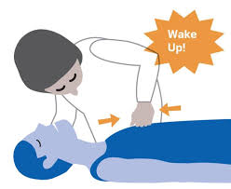
1. Check for signs of overdose
Wont wake up
Slow or no breathing
Pale, grey skin
Blue lips or fingertips
Snoring or gurgling sound
How do you know if someone is overdosing or just really high?
Really high
Relaxed muscles
Slow, slurred speech
Sleepy
Nodding out
Will respond to stimulation
Overdose
Blue lips, fingertips
Pale, clammy skin
Deep snoring/gurgling
Slow, or no breathing
Will not respond to stimulation
Check for a response!
Shake them, do a sternum rub, or pull on their ear lobes

Slide 8
How to respond to an overdose
Check for signs of overdose
Call 911
Administer Naloxone
Monitor person

Slide 9
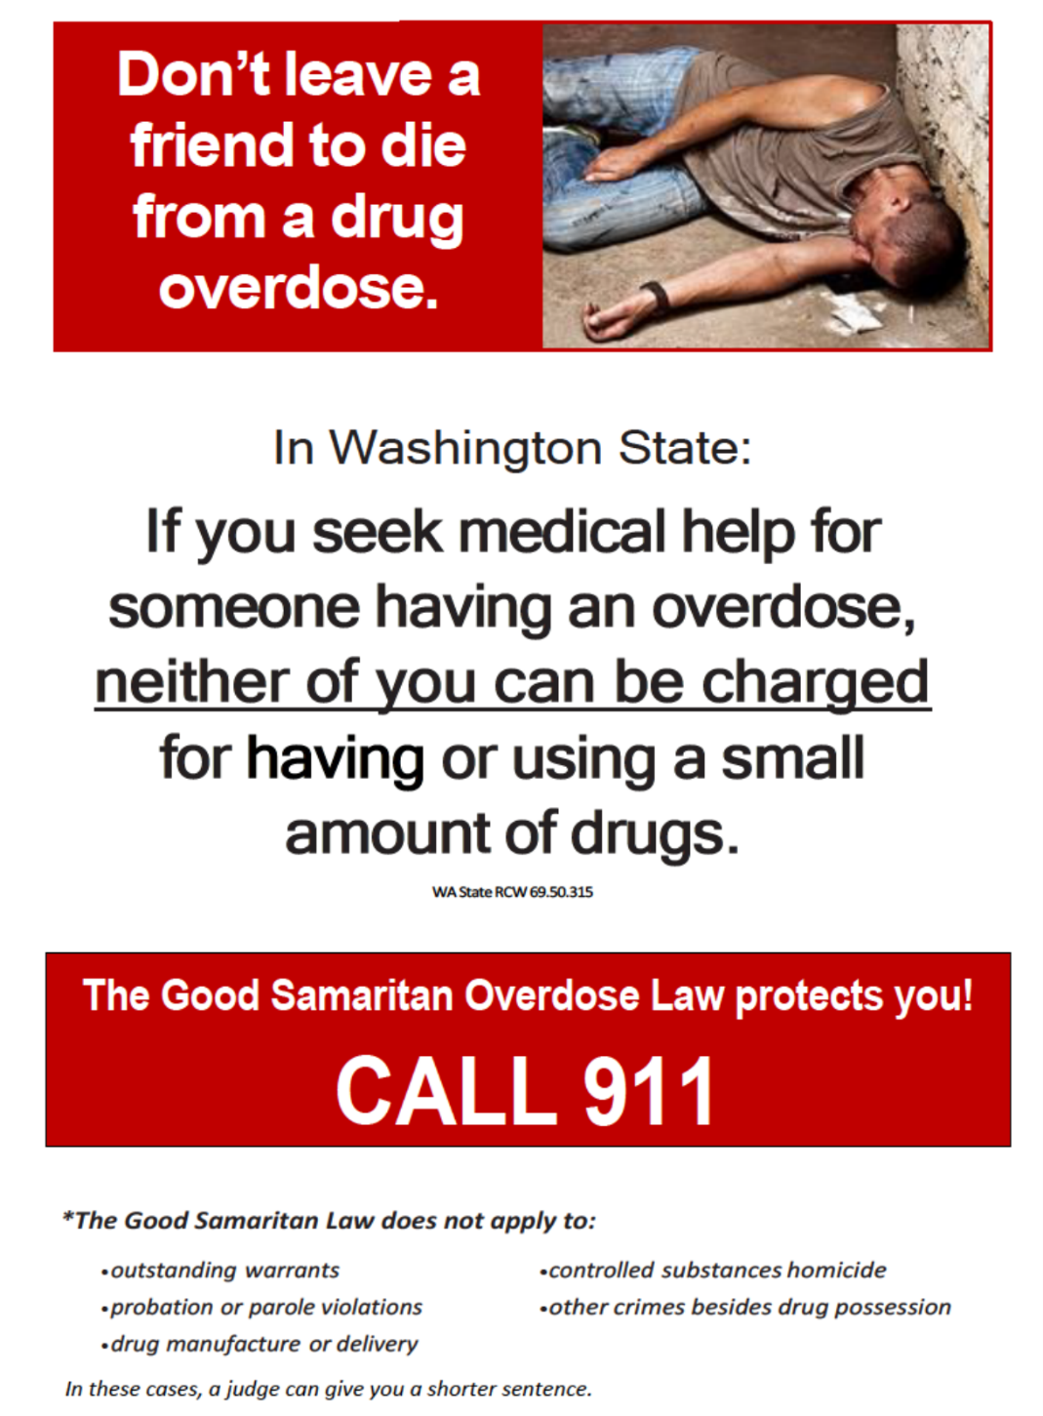
2. Call 911
Tell them the person is not breathing, unconscious, non-responsive
Give them the address and specific location
WA state has Good Samaritan law, which protects those involved in and responding to a drug overdose
There are no liability risks for you when trying to help an overdose victim

Slide 10
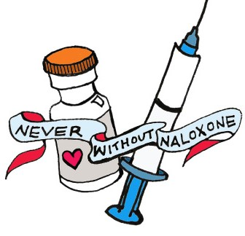
3. Administer IM naloxone
Take the orange cap off the vial
Draw up all the liquid into the syringe
Inject the needle straight into a muscle (upper arm, thigh, or buttock)
Begin rescue breathing
Wait 2-3 minutes, no response? Administer 2nd dose
Oxygen is critical in an overdose!
If person is not breathing, give rescue breaths between doses.
Lay person flat, tilt head, pinch nose, and provide one slow breath every 5 seconds.

Slide 11
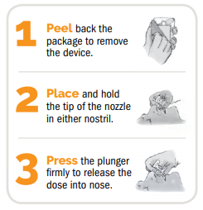
3. Administer nasal naloxone
Peel, place, press
Begin rescue breathing
Wait 2-3 minutes, no response? Administer 2nd dose
Oxygen is critical in an overdose!
If person is not breathing, give rescue breaths between doses.
Lay person flat, tilt head, pinch nose, and provide one slow breath every 5 seconds.

Slide 12
4. What next?
Stay with them
Roll to recovery position
They may experience mild to severe withdrawal symptoms like pain, sweating, and nausea
They may feel confused, anxious or slightly agitated, but rarely combative or violent
Naloxone wears off in 30-90 minutes, at which point it is possible that breathing may stop again

Slide 13
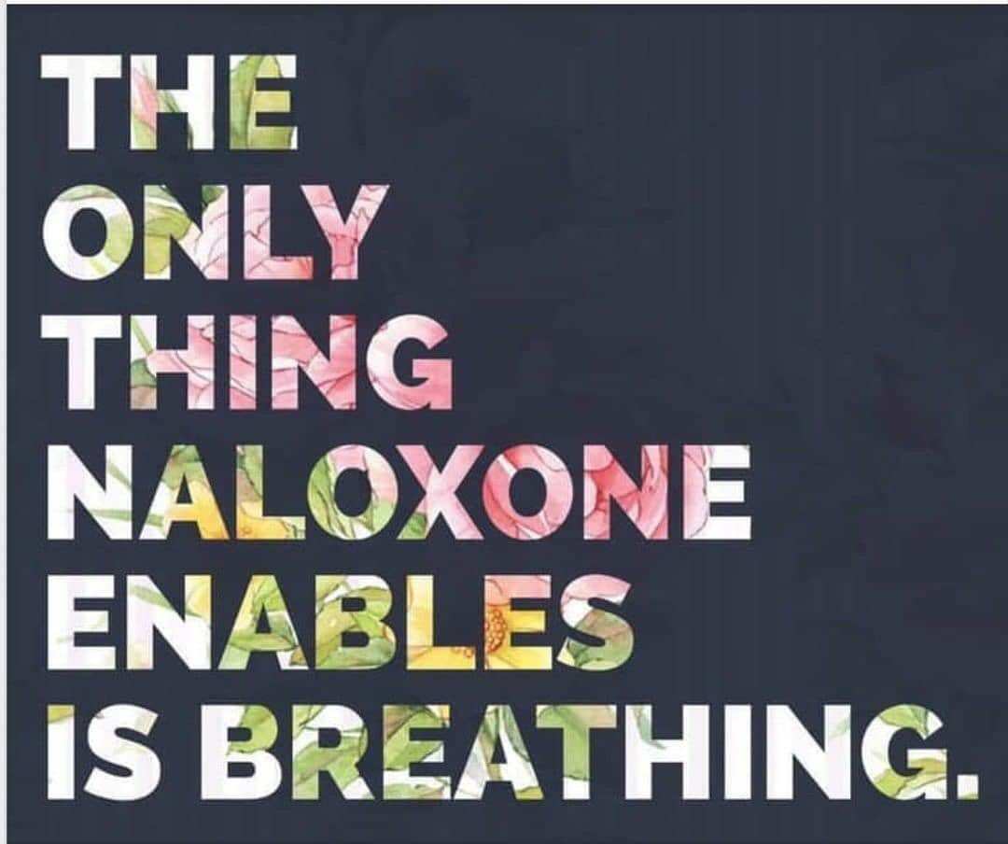
FAQ
Can you abuse Narcan?
What if I don’t know what drugs were taken?
Is it legal to carry Narcan?
When does it expire?
How do I store it?
How can I get more?
If you need a naloxone protocol for your organization, check the sample protocols on stopoverdose.org
Notes:
Can you abuse Narcan?
No! Narcan has no potential for abuse.
Is it legal to carry Narcan?
Yes! WA State law (RCW 69.41.095) allows anyone “at risk for having or witnessing a drug overdose” to obtain naloxone and administer it in an overdose. This includes people who use opioids, family members, friends and professionals. WA State’s 2015 “Naloxone law” also permits naloxone to be prescribed directly to an “entity” such as a police department, homeless shelter or social service agency for staff to administer if they witness an overdose when performing their professional duties.
It also permits non-medical persons to distribute naloxone under a prescriber’s standing order.
When does it expire?
Naloxone has a shelf life between 18mo and 2years and expiration dates are on the container. But don’t toss it when it expires! Get a new kit and keep the expired one as a backup. A 2018 study showed that naloxone is still effective at least 1 year after expiration.
How can I get more?
We always distribute IM kits at our exchange locations. You can contact me if you need replacements for nasal kits. You can also get it from pharmacies and may want to check your insurance coverage. (It is covered by Medicaid) There is a list of pharmacies by location that have it on stopoverdose.org
How do I store it?
Naloxone should be stored away from direct light and extreme temperatures. It will generally withstand Pacific Northwest temperatures inside car glove boxes, but should be removed in case of temperature extremes.
Things to consider for a naloxone protocol..
Steps for staff to follow to identify an overdose and call for help
Who is allowed to administer medical aid
How staff will be trained and given refresher trainings
Tracking expiration dates and storage
Point person for questions and training

Slide 14
Client Distribution
When giving your client/ participant a Naloxone kit make sure they know the following:
How to recognize an overdose
How to administer both the Intramuscular naloxone and the nasal Narcan
Where to keep it stored
The Good Samaritan Laws
Notes:
Can you abuse Narcan?
No! Narcan has no potential for abuse.
Is it legal to carry Narcan?
Yes! WA State law (RCW 69.41.095) allows anyone “at risk for having or witnessing a drug overdose” to obtain naloxone and administer it in an overdose. This includes people who use opioids, family members, friends and professionals. WA State’s 2015 “Naloxone law” also permits naloxone to be prescribed directly to an “entity” such as a police department, homeless shelter or social service agency for staff to administer if they witness an overdose when performing their professional duties.
It also permits non-medical persons to distribute naloxone under a prescriber’s standing order.
When does it expire?
Naloxone has a shelf life between 18mo and 2years and expiration dates are on the container. But don’t toss it when it expires! Get a new kit and keep the expired one as a backup. A 2018 study showed that naloxone is still effective at least 1 year after expiration.
How can I get more?
We always distribute IM kits at our exchange locations. You can contact me if you need replacements for nasal kits. You can also get it from pharmacies and may want to check your insurance coverage. (It is covered by Medicaid) There is a list of pharmacies by location that have it on stopoverdose.org
How do I store it?
Naloxone should be stored away from direct light and extreme temperatures. It will generally withstand Pacific Northwest temperatures inside car glove boxes, but should be removed in case of temperature extremes.
Things to consider for a naloxone protocol..
Steps for staff to follow to identify an overdose and call for help
Who is allowed to administer medical aid
How staff will be trained and given refresher trainings
Tracking expiration dates and storage
Point person for questions and training

Slide 15
QUESTIONS

Slide 16
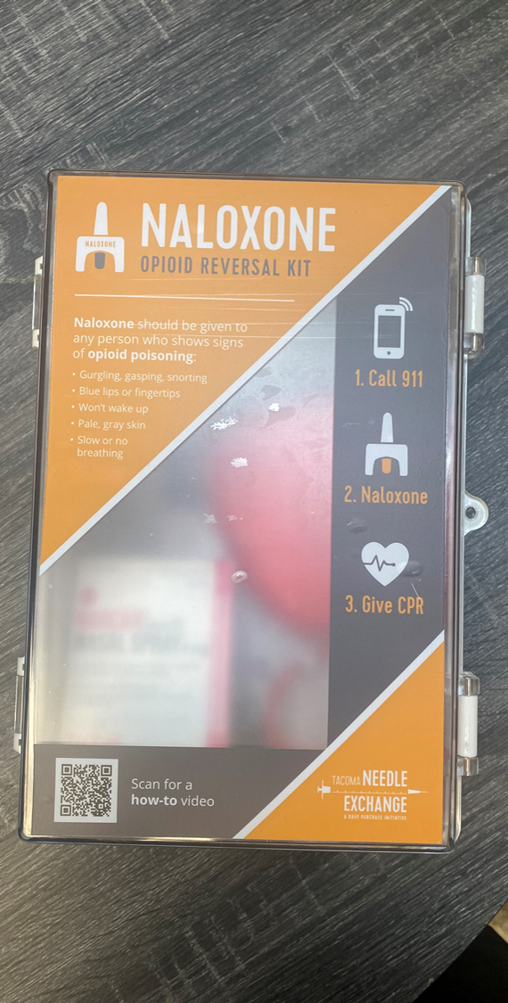
Naloxone Kit
Nasal Narcan
Rescue Breathing CPR Mask
Instruction Guide
Waterproof Case
Contact
Stephanie Prohaska at
Stephanie@nasen.org or
Paul LaKosky at
Paul@nasen.org

Slide 17
For more information:
Stephanie Prohaska
Stephanie@nasen.org
tacomaneedleexchange.org
stopoverdose.org
Notes:
Questions?

