Slide 1
Pierce County DEM: Emergency Preparedness Update
June 27, 2024

Slide 2
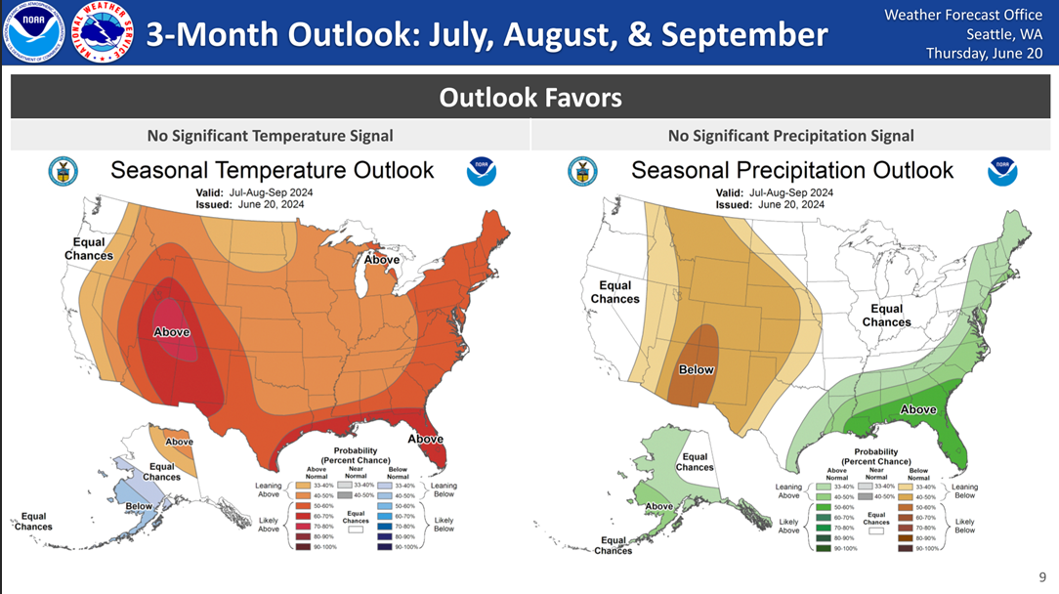
NWS Forecast: July-September 2024

Slide 3
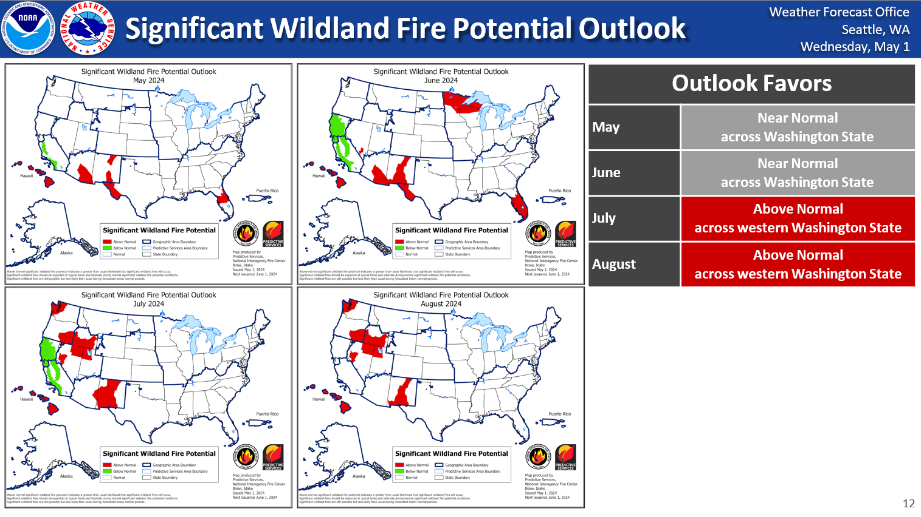
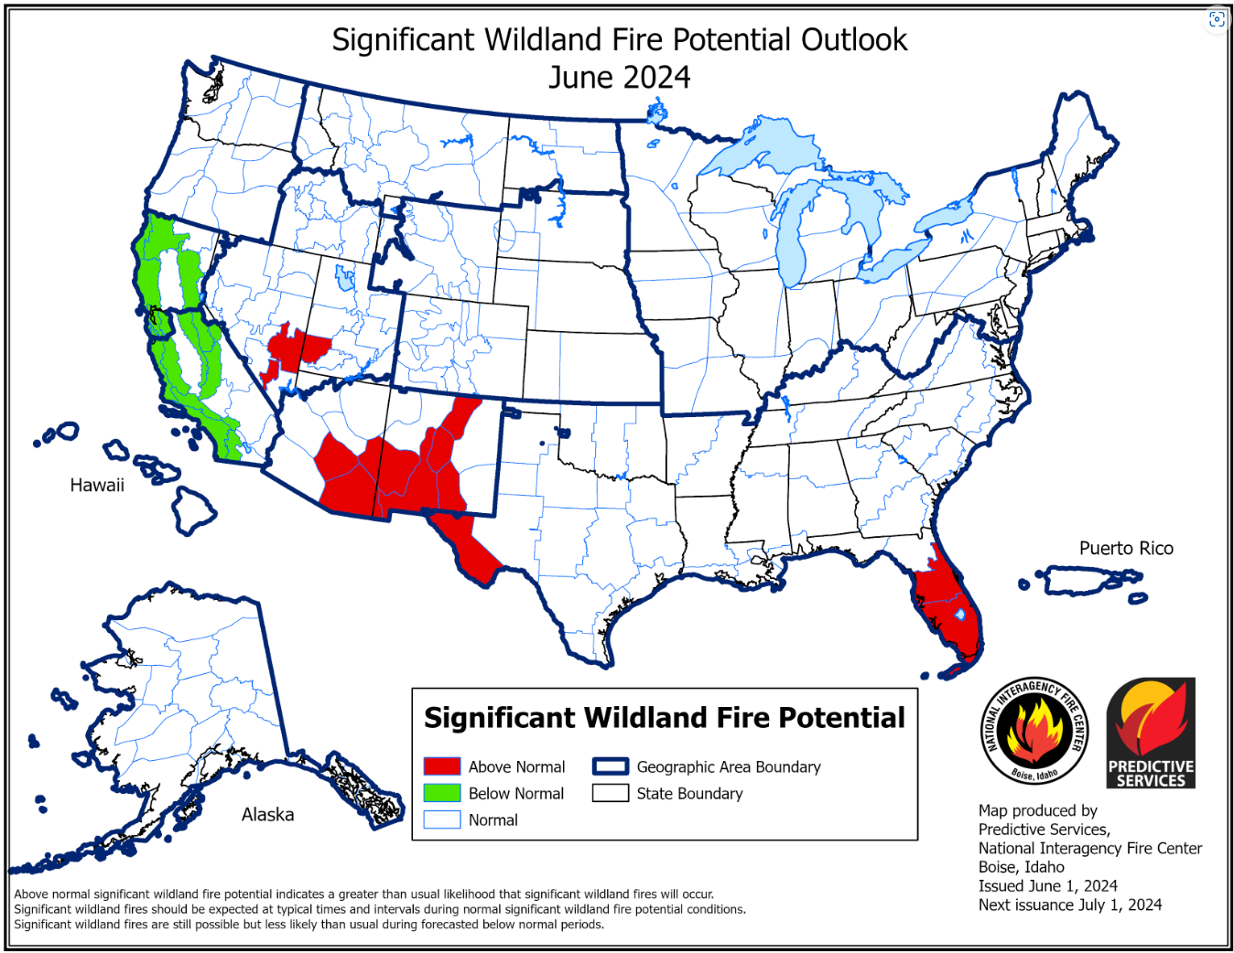
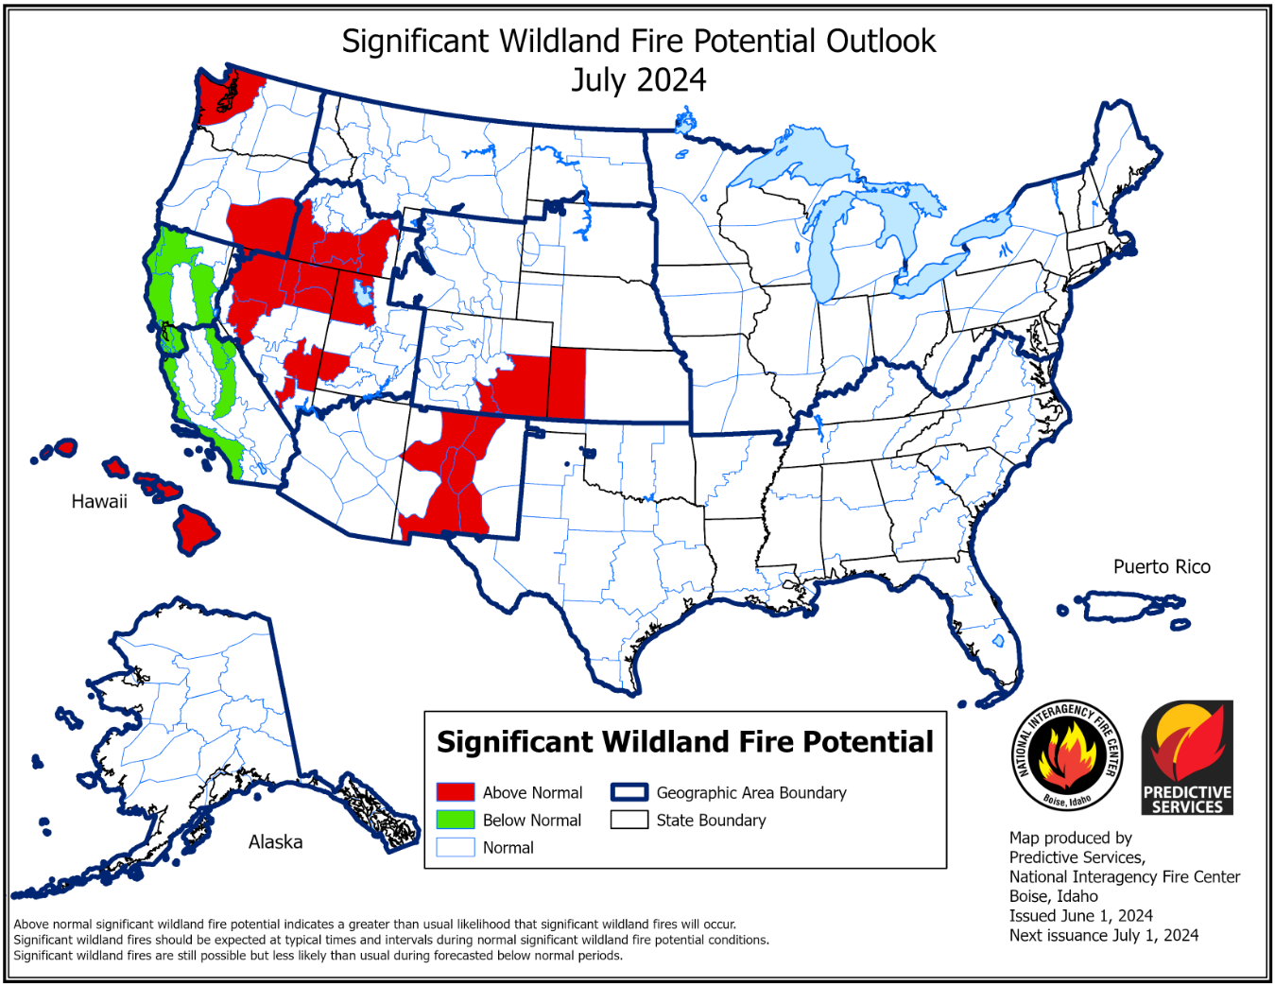
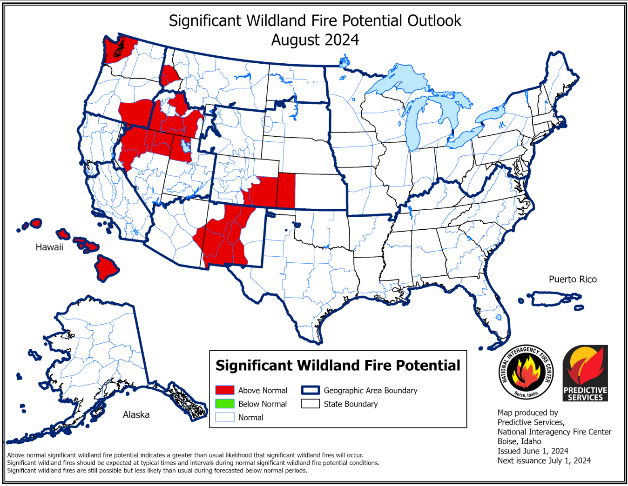
NWS Forecast: 2024 Wildfire Outlook

Slide 4
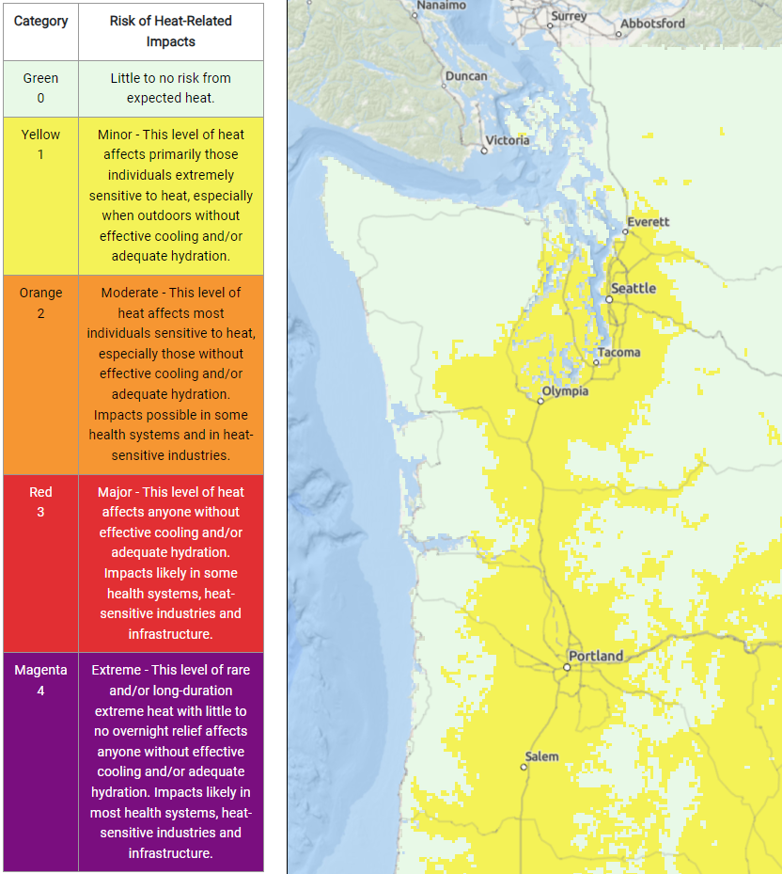
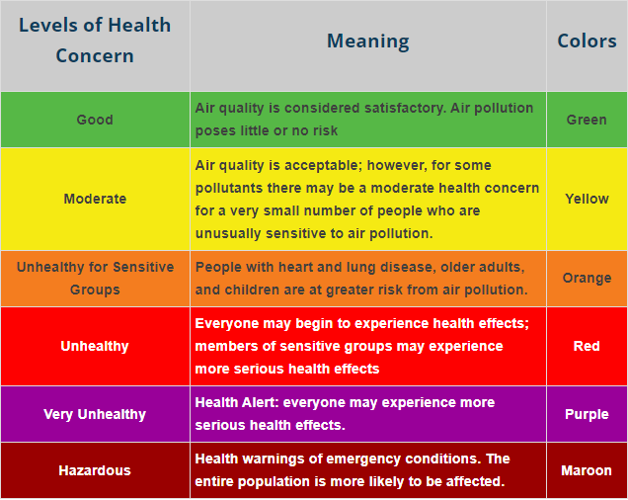
Tools & Resources
National Weather Service (NWS) HeatRisk tool:
https://www.wpc.ncep.noaa.gov/heatrisk/?wfo=sew
Puget Sound Clean Air Agency (PSCAA) Air Quality Index:
https://secure.pscleanair.org/AirQuality/NetworkMap

Slide 5
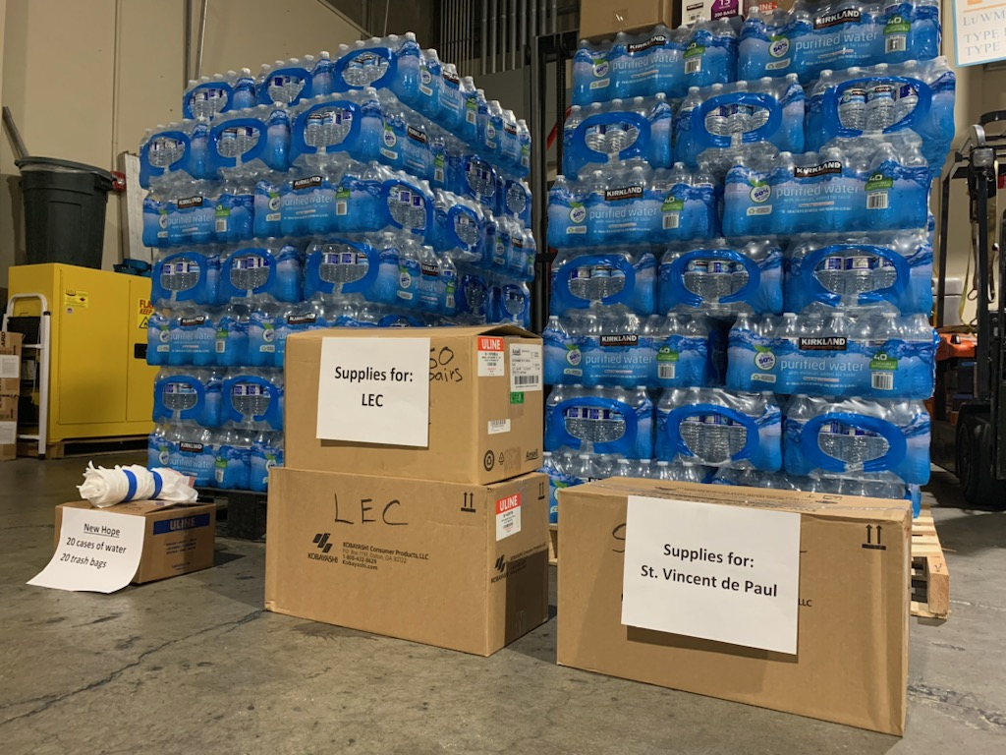
Extreme Weather Plan
Identifies PCEOC’s response criteria & resources
Level III – Duty Officer
Level II – Partial EOC Activation
Level 1 – Full EOC Activation
Activation criteria based on several factors:
NWS HeatRisk level
PSCAA air quality index level
Local jurisdiction need/request
Resources identified based on EOC activation level
Hyperthermia kits, cooling centers, overnight shelters, information via social media & website, etc.

Slide 6
Emergency Preparedness

Slide 7
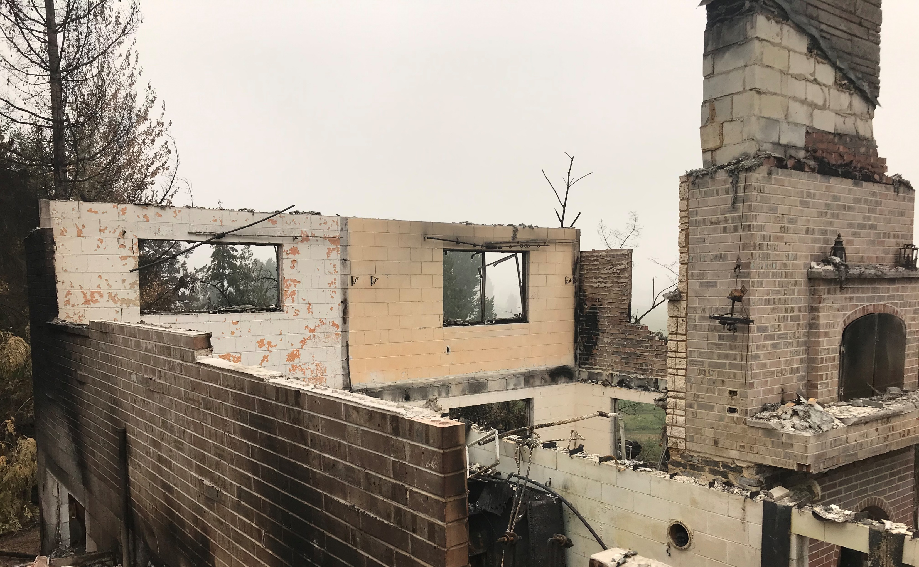
Make a Plan
Communication Plan
Emergency contact list
Work & School
Out of State contact
Reunification Plan
Home location
Remote location
Evacuation Plan
Know your routes
Evacuation levels

Slide 8
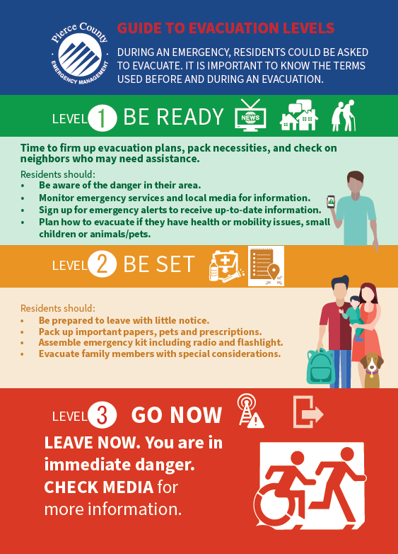
Evacuation Levels
Pierce County and local agencies have updated our evacuation language to make it more understandable for residents.
Language combines evacuation levels (1,2,3) and actions (Ready, Set, Go).

Slide 9
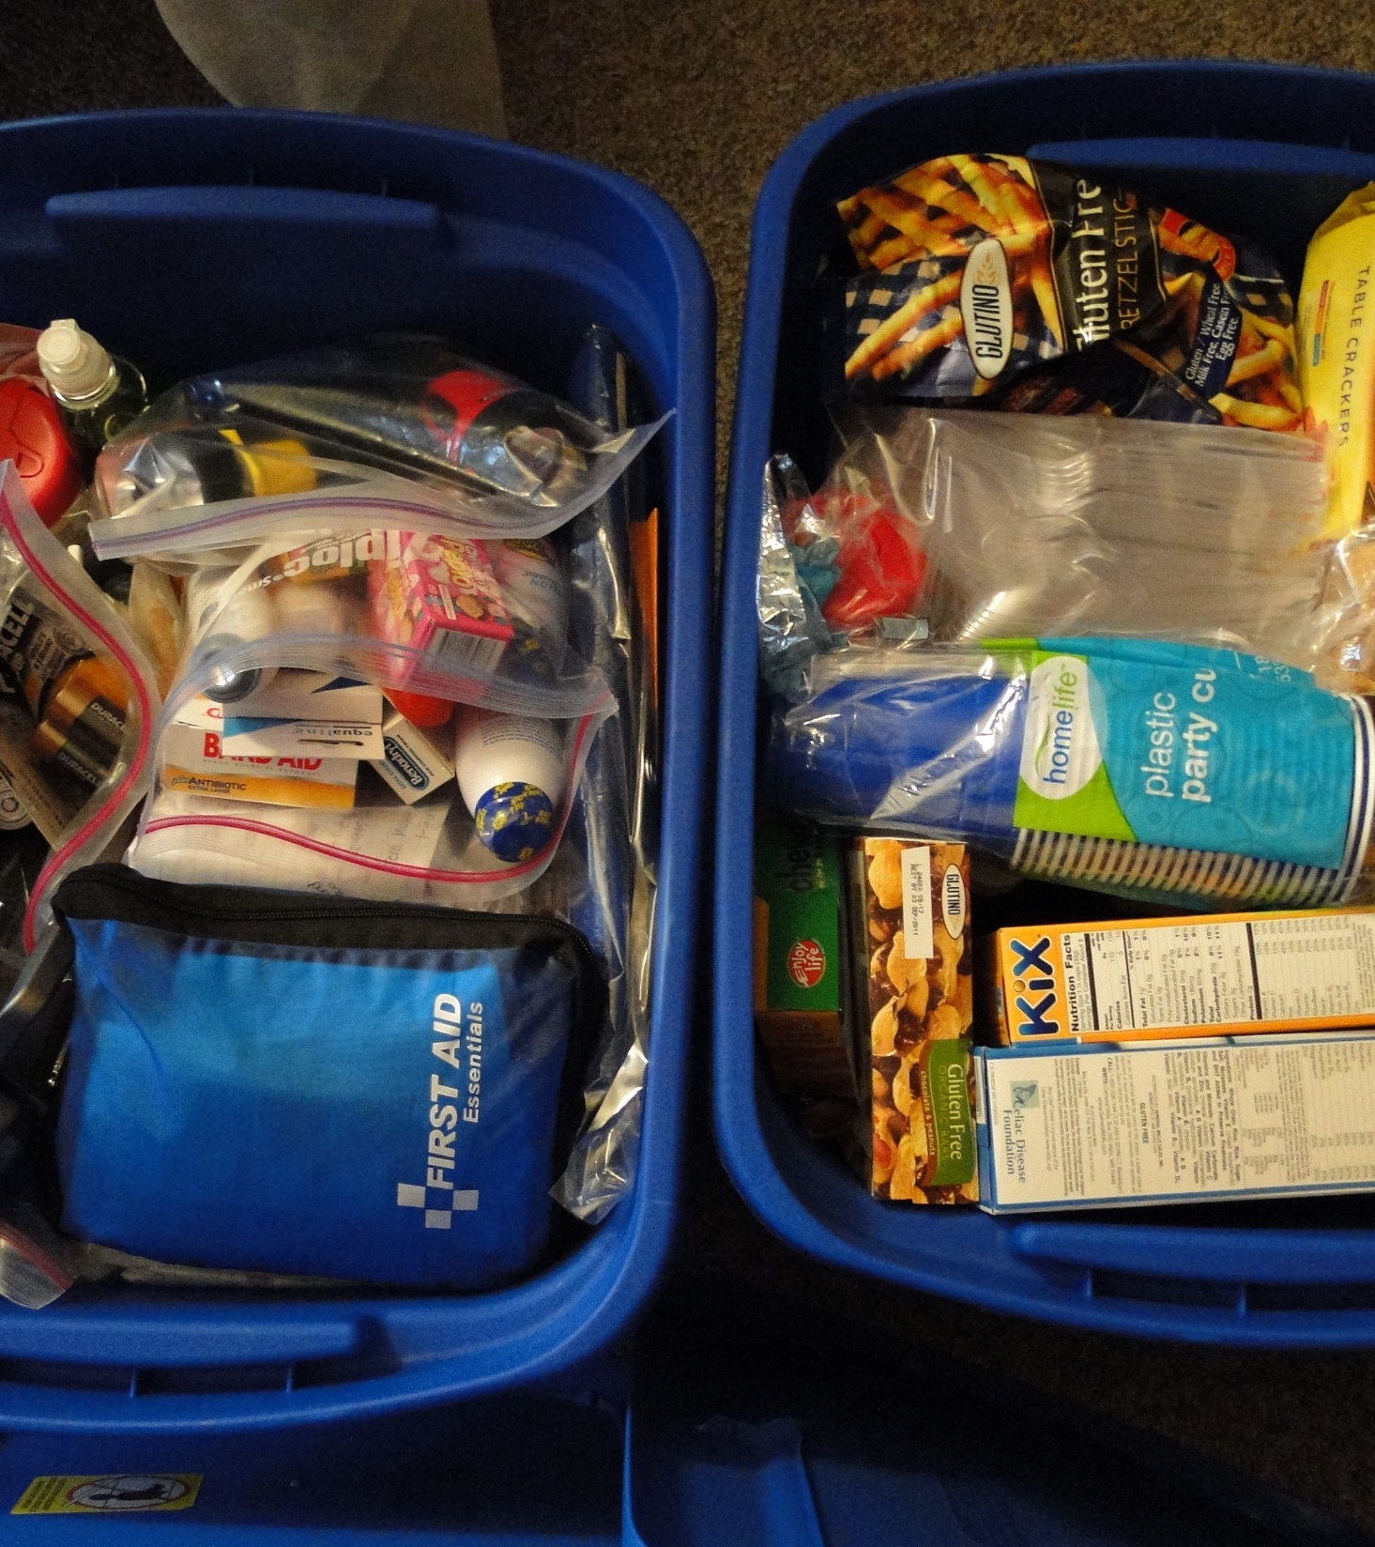
Personal Preparedness
Build a Kit
Go-Kit
Car Go-Kit
14 days prepared
Store Water
CDC recommendation
Alternative water supply
Life Straw (1300 gallons)
Who has their own kit?
What makes it personal to you and your family?

Slide 10
Kit Essentials
Build a Go Kit
Thirty days of medication
Extra assistive items
Cane or eyeglasses
Consider dietary restrictions
Batteries to back-up power dependent devices
Prepare Key Documents
Identification
Financial and legal papers
List of medical information

Slide 11
SIGN UP FOR ALERTS
QR code and text-in option to receive PCALERTs specific to extreme weather.
QR code is printed on both the hot weather and cold weather kits.

Slide 12
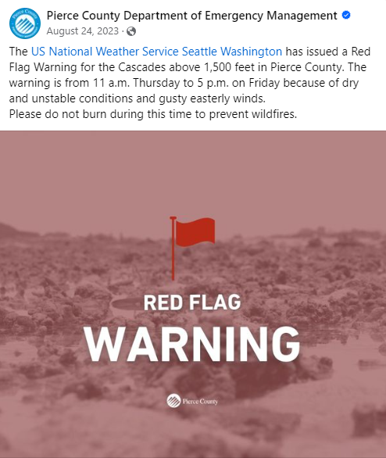
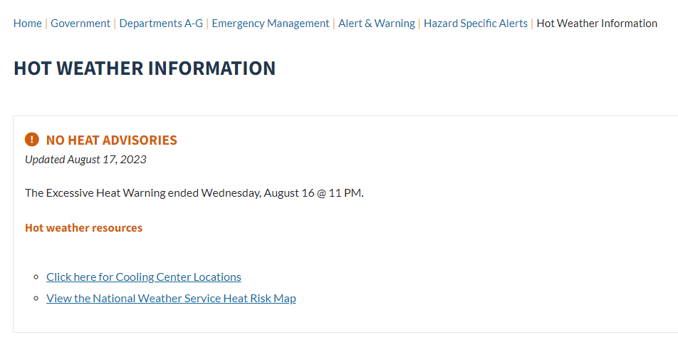
Hazard Information
Hot Weather Information | Pierce County, WA - Official Website (piercecountywa.gov)
Pierce County Department of Emergency Management | Tacoma WA | Facebook

Slide 13
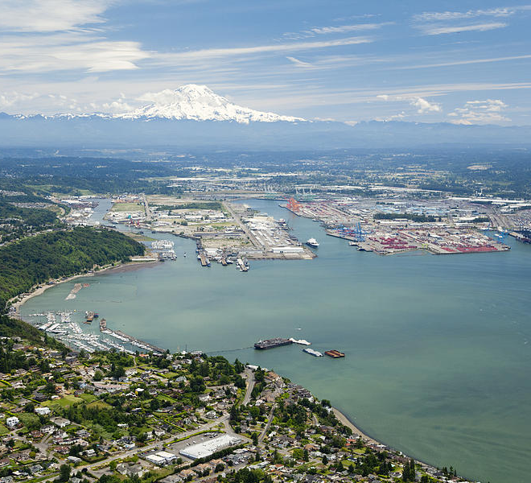
QUESTIONS?
Wyatt Godfrey
Mass Care Coordinator
Pierce County Emergency Management
wyatt.godfrey@piercecountywa.gov

