Slide 1
Homeless Crisis Continues
What’s being done to care for our most vulnerable neighbors?

Slide 2
Historical Timeline
State of Emergency Declared COT Mayor
Pierce County Homeless Coalition formed
Stability Site
2018
Nativity House Respite Piloted
NW Hospitality (Kitsap County)
2019-20
2021-2025
2017
COVID
Nativity House Respite permanently established
Safe Parking Shelter Piloted (now established throughout PC)
Additional Homeless Coalitions formed (Continue)
Homelessness deemed #1 most pressing issue in Washington State
2021: Medical Respite Steering Committee formed
2023: Medicaid Transportation Project (MTP)-continues until 2028
2024: CR 101 filed (Preproposal for Medical Respite for PEH)-awaiting sponsorship currently
2025: Medical Respite WAC introduced-open forum Aug 2025
“There will always be poor people in the land. Therefore, I command you to be openhanded toward [those] who are poor and needy in your land”
Deuteronomy 15:11
Notes:
This is a snapshot of what I have been involved in—there has been a lot of movement around providing medical care to PEH throughout the state as our latest updates will show.

Slide 3
Latest Updates
Community Involvement remains active
Pierce County Homeless Coalition, GHKP Homeless Coalition, NW Hospitality continues to be actively engaged & effective at assisting People experiencing Homelessness (PEH)
Note Number of clients served in 2024
State involvement remains active
CR 101 Medical Respite
HCA is in the process of finalizing a WAC around medical respite
Public hearing is tentatively scheduled for August 5th at 10 am
Future providers involved
Nursing Schools around the area are preparing future nurses to care for PEH
Notes:
Pierce County Homeless Coalition:
GHKP Homeless Coalition
NW Hospitality ( https://www.nwhospitality.org/?gad_source=1&gad_campaignid=1392971454&gbraid=0AAAAADACw-SHw-tfCwdnNzpMXCn_7VErX&gclid=CjwKCAjwvO7CBhAqEiwA9q2YJRkgfxT-HUMRLcMnbqvT3Ofi0gXcmQH9tBLaf-eK1SRSRM8dOdoMChoCKkIQAvD_BwE )

Slide 4
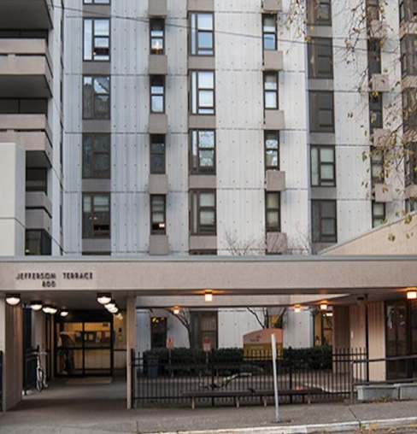
State Level: Health Care Authority
Medicaid Transformation Project (MTP)- meant to improve Washington’s healthcare system for most vulnerable neighbors
Currently: 8 known Medical Respite Care Programs (2/8 reimbursed)*
*Seattle-Edward Thomas House; Yakima Neighborhood Health Services Medical Respite being reimbursed through contracts with 5 Apple Health Managed Care Organizations (MCOs)
Based in homeless shelters, offer ‘wrap around’ services
Medical & behavioral health provided by Federally Qualified Health Centers (FQHC)
Notes:
MTP: On June 30, 2023, CMS approved MTP to continue for five more years. Our state's MTP renewal, called MTP 2.0, will help widen our reach to provide more programs, services, and supports to our most vulnerable populations. MTP allows our state to create and continue to develop projects, activities, and services that improve Washington’s health care system.
*Historically, reimbursement has not been available until recently. Refer to pdf on Medical respite programs for PEH: https://www.hca.wa.gov/assets/billers-and-providers/medical-respite-care-programs.pdf
“Wrap Around” services: care transitions and coordination/medical case management, outreach, medication management, care plan development, education, connections to health care providers, enrollment in benefits, assessment of behavioral health care needs, crisis stabilization, and housing assessments/referrals

Slide 5
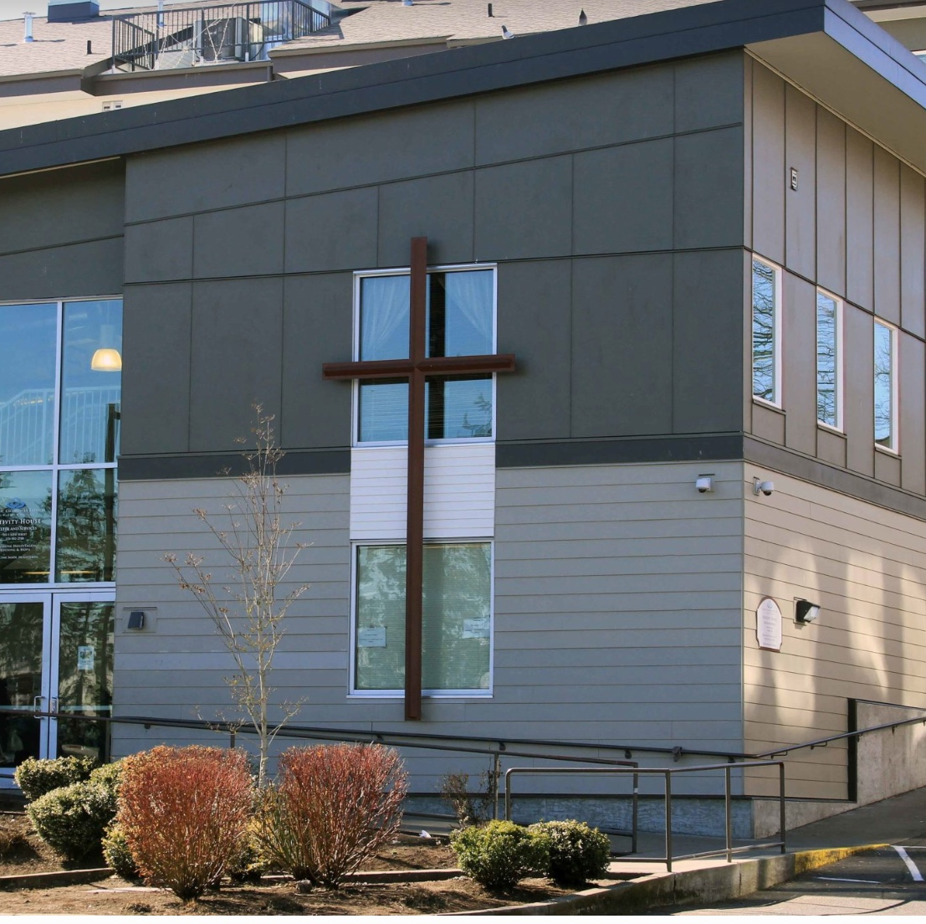
More Medical Respites coming for PEH
Medical Respite Steering committee continues to partner with community and private organizations & citizens
Yakima Ave Health for ALL (Free) Clinic-Nativity House

Slide 6
Questions? Comments?

