Slide 1
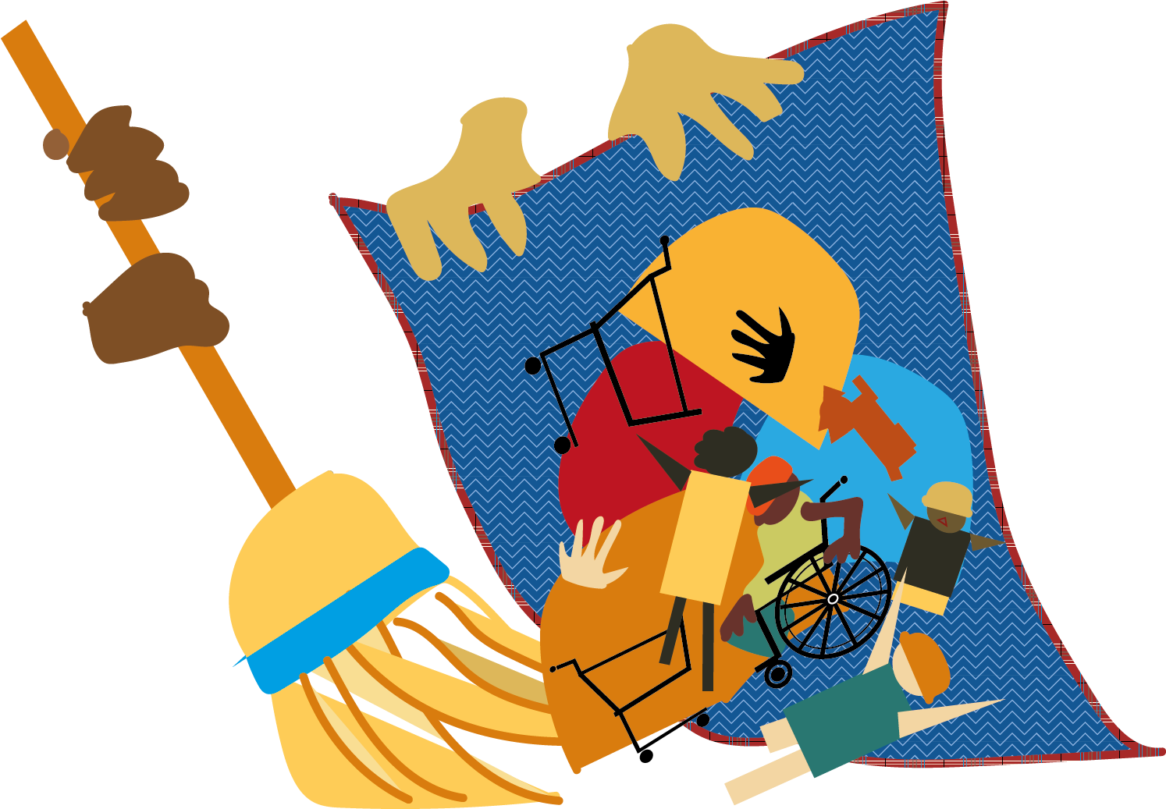
Martin V. Boise
8th Amendment Argument
September 4, 2018: The 9th Circuit Court ruled that ordinances prohibiting homeless individuals from sleeping or camping on public property are unconstitutional when those individuals do not have a meaningful alternative, such as shelter space or a legal place to camp.
Punishing people who cannot obtain shelter for sitting, sleeping, or lying outside on public property is “cruel and unusual punishment.”
Unsheltered People
Why it Matters
Community
If you are asked to leave a public space, you have a right to ask where you can go.
If no other place is offered, and you are not violating any other law, you may have a right to stay.
Expensive litigation can be avoided by striking down illegal ordinances.
This is an opportunity to invest in measures to prevent and end homelessness.
Step 1: establish safe, legal places to camp and park.
Safe Sites 4 All Campaign: https://ss4a.pchomeless.org
Free use graphic created by Tacoma artist, Laurie Davenport
Use this space to write a short conclusion for
your infographic and/or to provide a call-to-action.

